Slide 1
Chapter 2 Introduction to C Programming

Slide 2
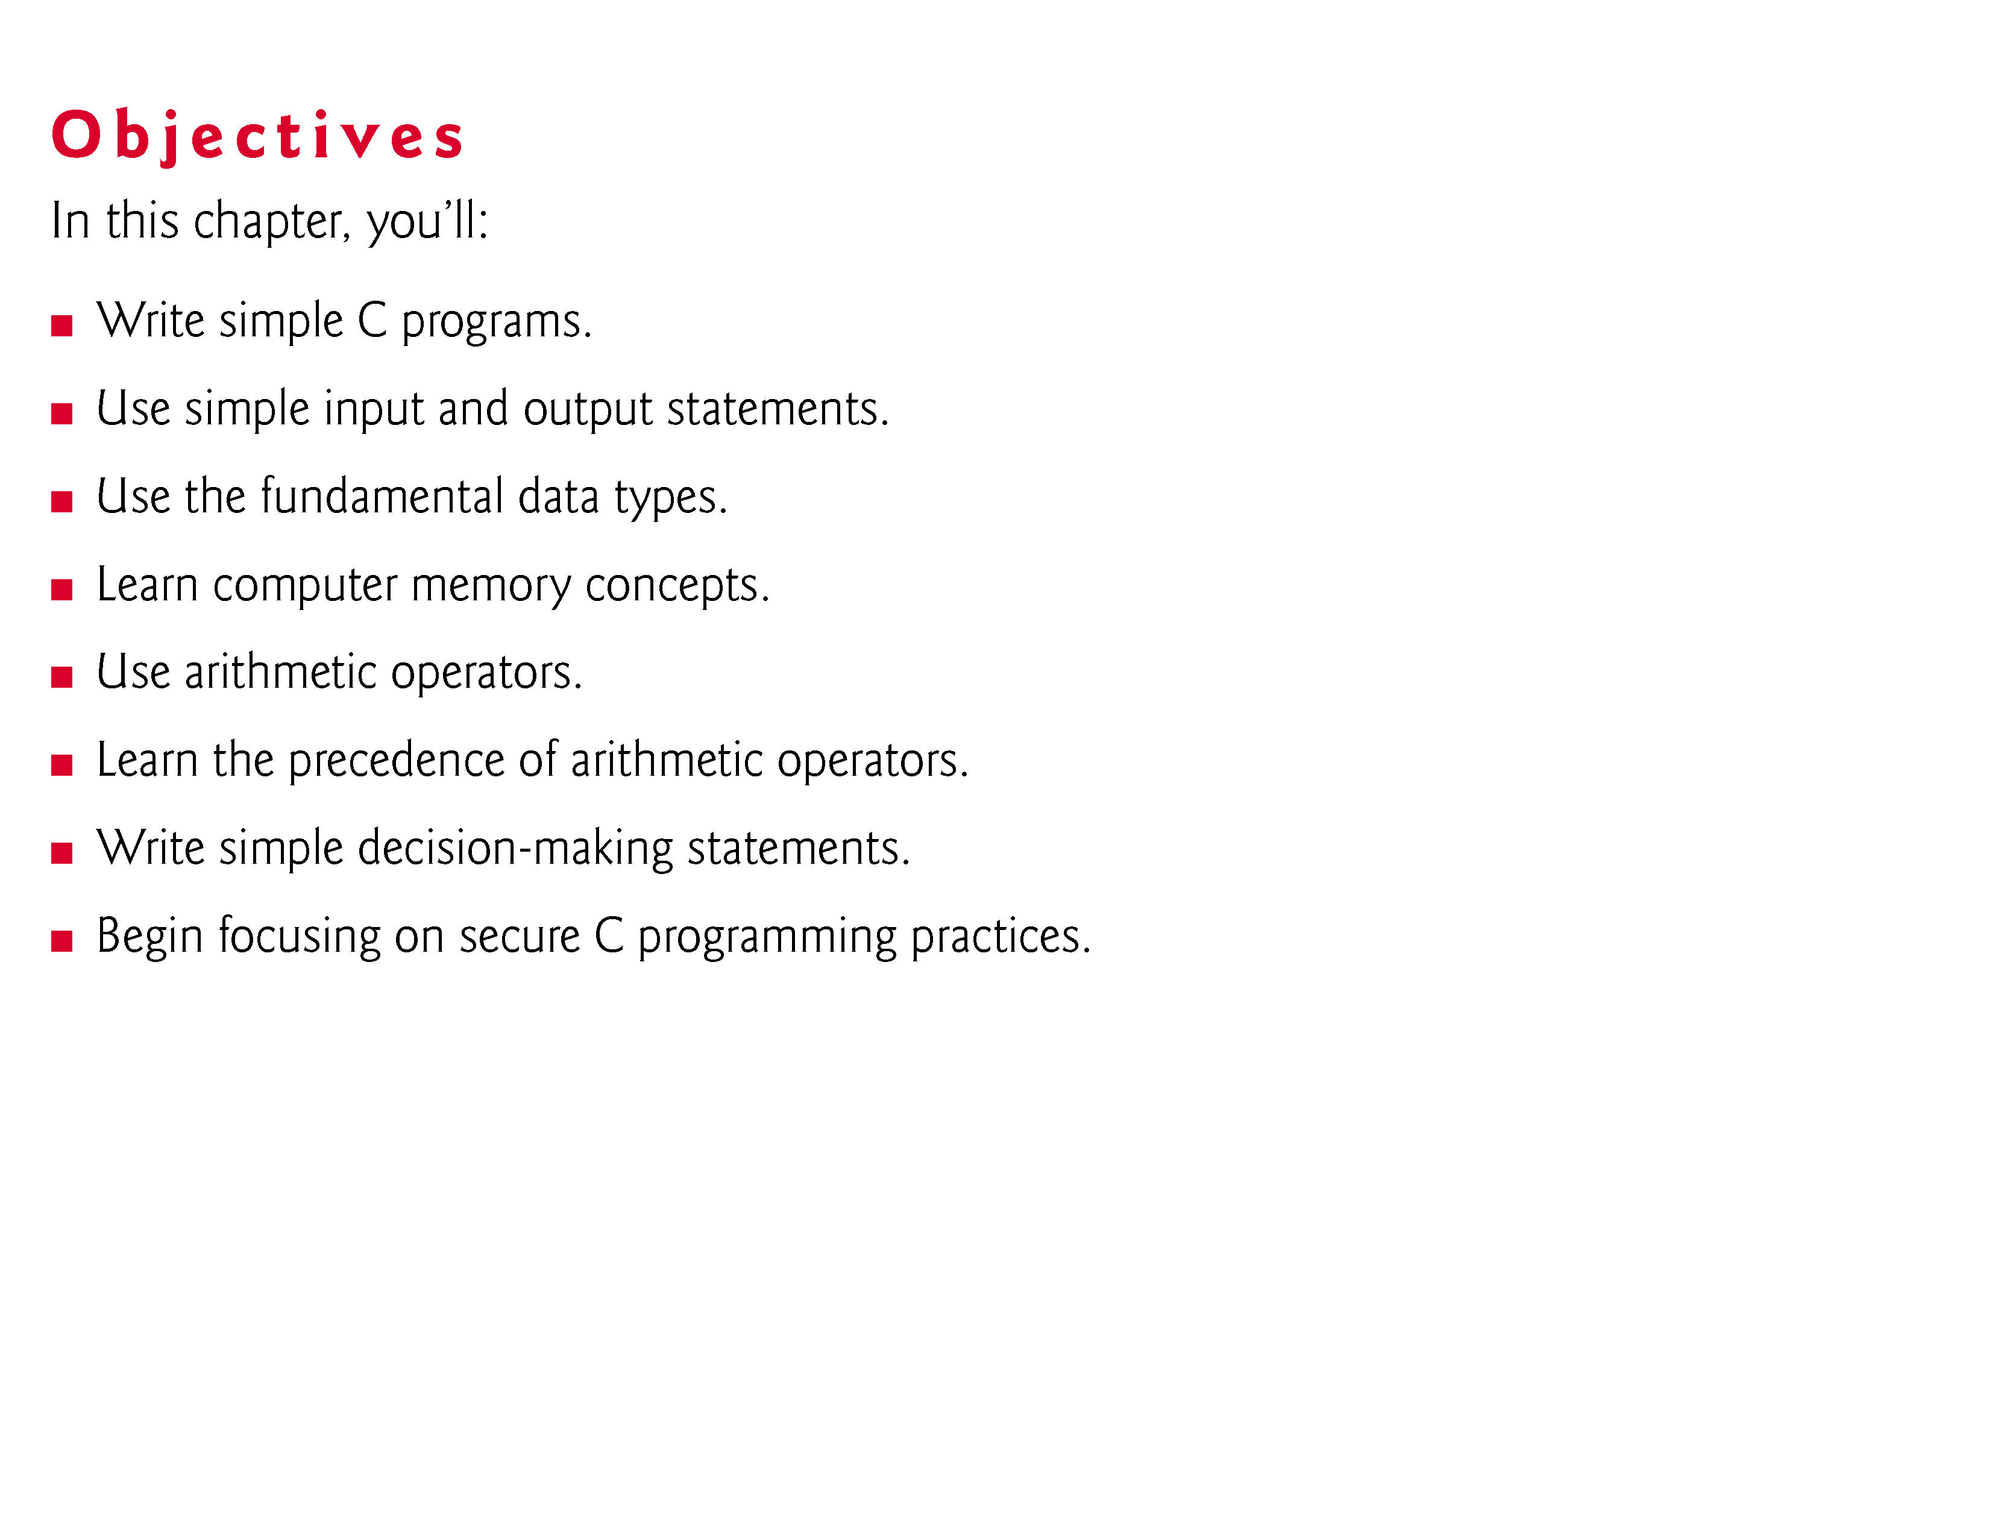

Slide 3
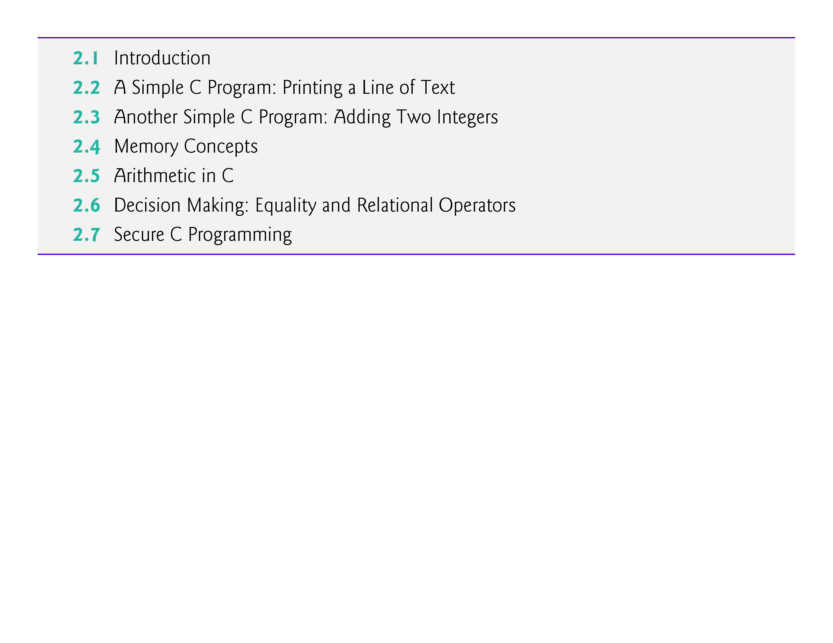

Slide 4
2.1 Introduction
The C language facilitates a structured and disciplined approach to computer program design.
In this chapter we introduce C programming and present several examples that illustrate many important features of C.
In Chapters 3 and 4 we present an introduction to structured programming in C.

Slide 5
2.2 A Simple C Program: Printing a Line of Text
We begin by considering a simple C program.
Our first example prints a line of text (Fig. 2.1).

Slide 6
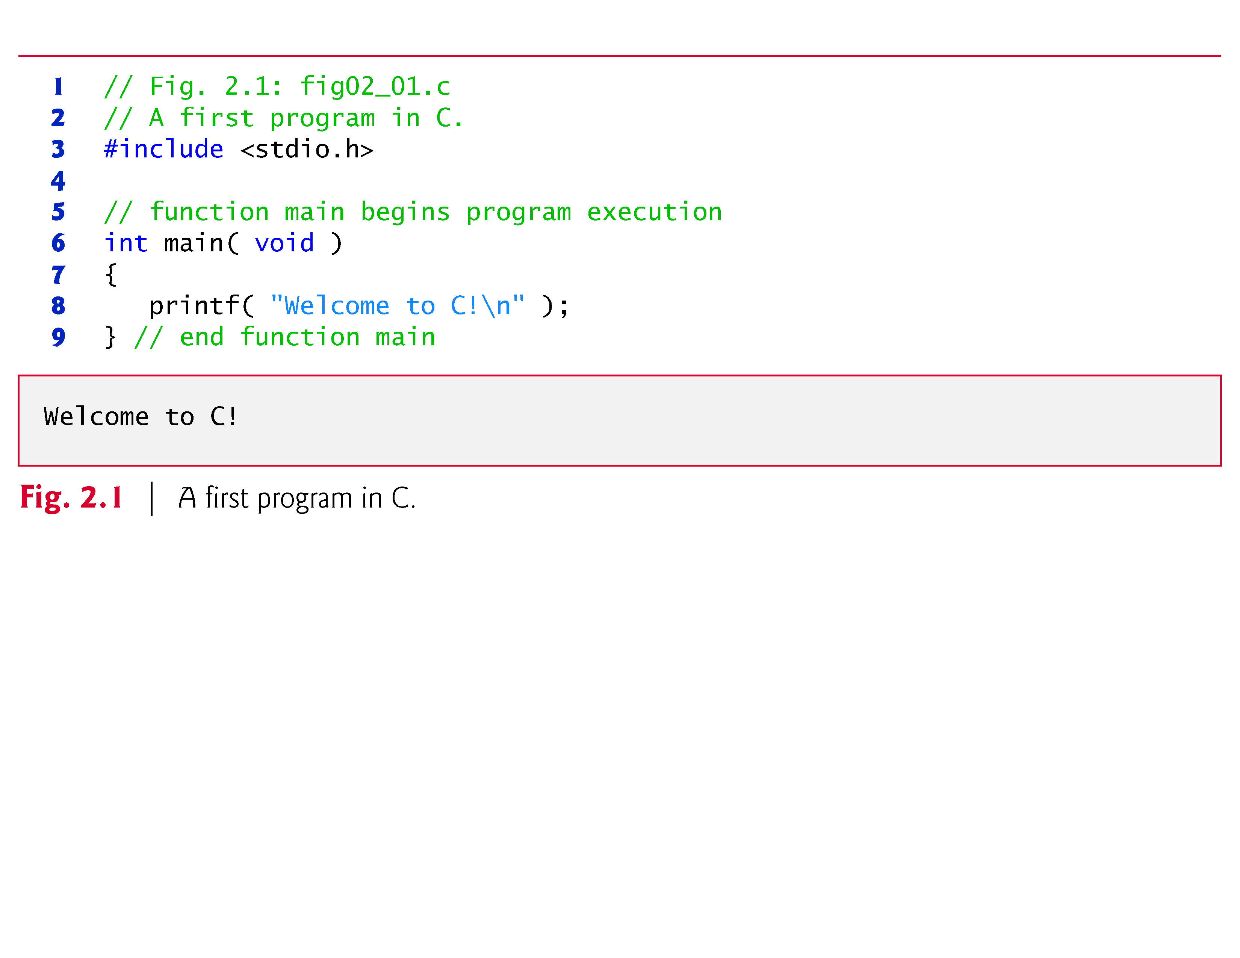

Slide 7
2.2 A Simple C Program: Printing a Line of Text (Cont.)
// Fig. 2.1: fig02_01.c // A first program in C
begin with //, indicating that these two lines are comments.
Comments document programs and improve program readability.
Comments do not cause the computer to perform any action when the program is run.

Slide 8
2.2 A Simple C Program: Printing a Line of Text (Cont.)
Comments are ignored by the C compiler and do not cause any machine-language object code to be generated.
Comments also help other people read and understand your program.

Slide 9
2.2 A Simple C Program: Printing a Line of Text (Cont.)
You can also use /*…*/ multi-line comments in which everything from /* on the first line to */ at the end of the line is a comment.
We prefer // comments because they’re shorter and they eliminate the common programming errors that occur with /*…*/ comments, especially when the closing */ is omitted.
#include Preprocessor Directive
#include <stdio.h>
is a directive to the C preprocessor.

Slide 10
2.2 A Simple C Program: Printing a Line of Text (Cont.)
Lines beginning with # are processed by the preprocessor before compilation.
Line 3 tells the preprocessor to include the contents of the standard input/output header (<stdio.h>) in the program.
This header contains information used by the compiler when compiling calls to standard input/output library functions such as printf.
Blank Lines and White Space
You use blank lines, space characters and tab characters (i.e., “tabs”) to make programs easier to read.
Together, these characters are known as white space. White-space characters are normally ignored by the compiler.

Slide 11
2.2 A Simple C Program: Printing a Line of Text (Cont.)
The main Function
int main( void )
is a part of every C program.
The parentheses after main indicate that main is a program building block called a function.

Slide 12
2.2 A Simple C Program: Printing a Line of Text (Cont.)
C programs contain one or more functions, one of which must be main.
Every program in C begins executing at the function main.
The keyword int to the left of main indicates that main “returns” an integer (whole number) value.
We’ll explain what it means for a function to “return a value” when we demonstrate how to create your own functions in Chapter 5.

Slide 13
2.2 A Simple C Program: Printing a Line of Text (Cont.)
For now, simply include the keyword int to the left of main in each of your programs.
Functions also can receive information when they’re called upon to execute.
The void in parentheses here means that main does not receive any information.

Slide 14
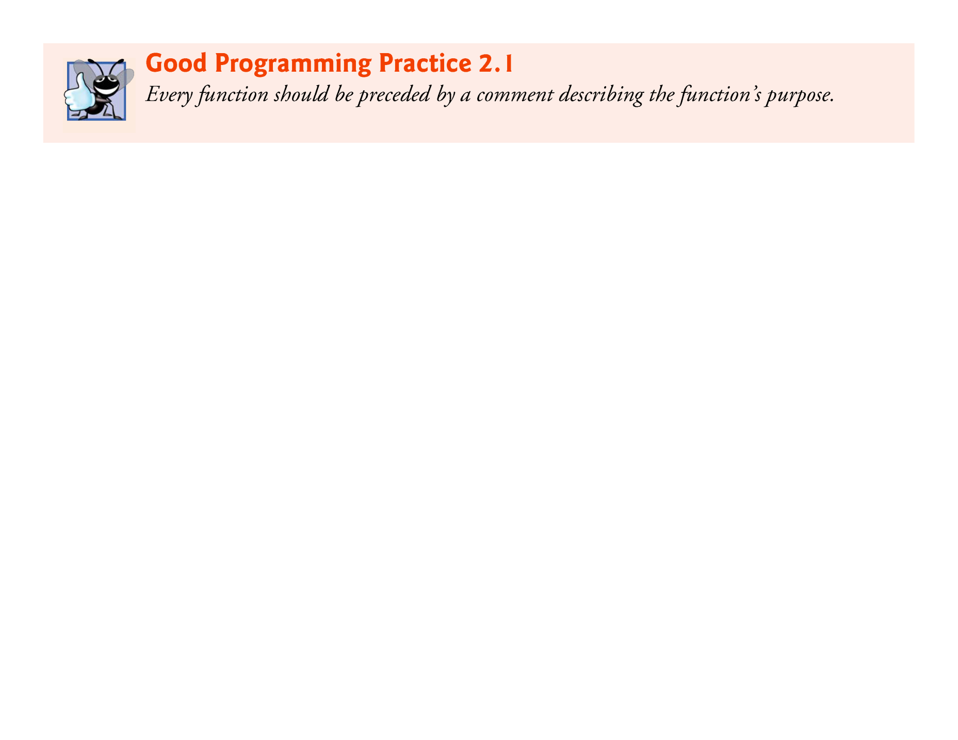

Slide 15
2.2 A Simple C Program: Printing a Line of Text (Cont.)
A left brace, {, begins the body of every function
A corresponding right brace ends each function
This pair of braces and the portion of the program between the braces is called a block.
An Output Statement
printf( "Welcome to C!\n" );
instructs the computer to perform an action, namely to print on the screen the string of characters marked by the quotation marks.
A string is sometimes called a character string, a message or a literal.

Slide 16
2.2 A Simple C Program: Printing a Line of Text (Cont.)
The entire line, including the printf function (the “f” stands for “formatted”), its argument within the parentheses and the semicolon (;), is called a statement.
Every statement must end with a semicolon (also known as the statement terminator).
When the preceding printf statement is executed, it prints the message Welcome to C! on the screen.
The characters normally print exactly as they appear between the double quotes in the printf statement.
Escape Sequences
Notice that the characters \n were not printed on the screen.
The backslash (\) is called an escape character.
It indicates that printf is supposed to do something out of the ordinary.

Slide 17
2.2 A Simple C Program: Printing a Line of Text (Cont.)
When encountering a backslash in a string, the compiler looks ahead at the next character and combines it with the backslash to form an escape sequence.
The escape sequence \n means newline.
When a newline appears in the string output by a printf, the newline causes the cursor to position to the beginning of the next line on the screen.
Some common escape sequences are listed in Fig. 2.2.

Slide 18
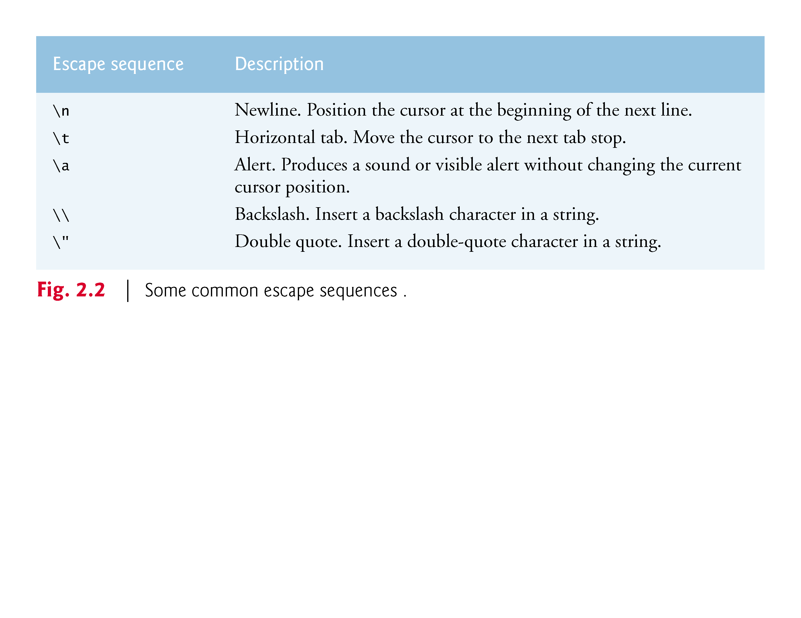

Slide 19
2.2 A Simple C Program: Printing a Line of Text (Cont.)
Because the backslash has special meaning in a string, i.e., the compiler recognizes it as an escape character, we use a double backslash (\\) to place a single backslash in a string.
Printing a double quote also presents a problem because double quotes mark the boundaries of a string—such quotes are not printed.
By using the escape sequence \" in a string to be output by printf, we indicate that printf should display a double quote.
The right brace, }, indicates that the end of main has been reached.

Slide 20
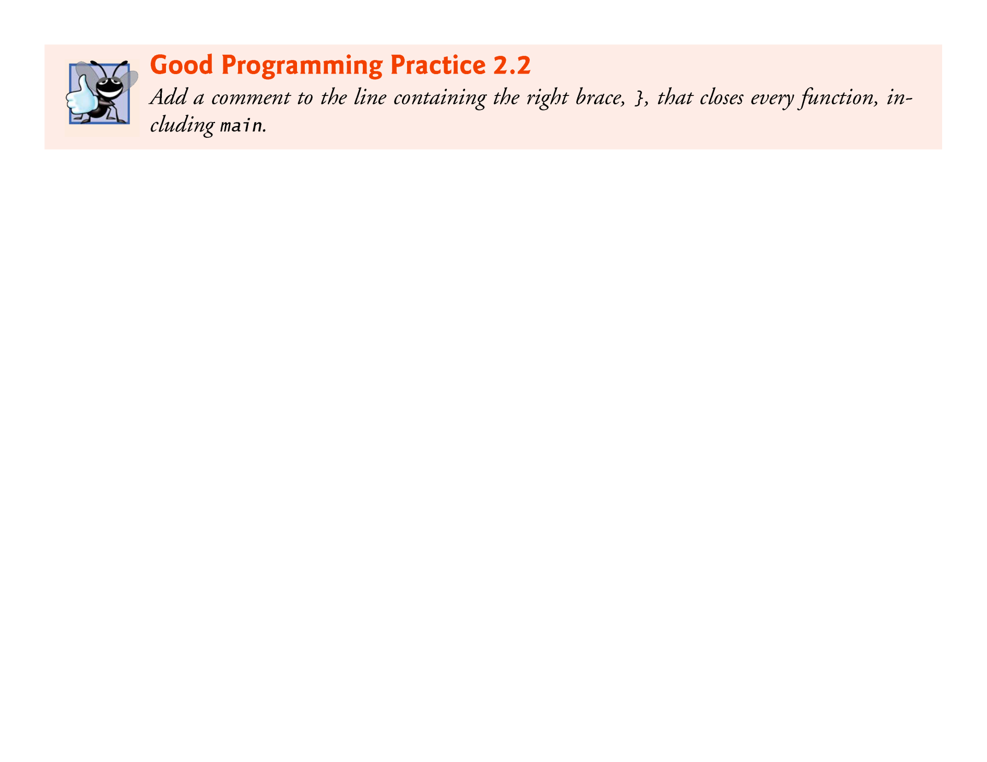

Slide 21
2.2 A Simple C Program: Printing a Line of Text (Cont.)
We said that printf causes the computer to perform an action.
As any program executes, it performs a variety of actions and makes decisions.
Chapter 3 discusses this action/decision model of programming in depth.

Slide 22
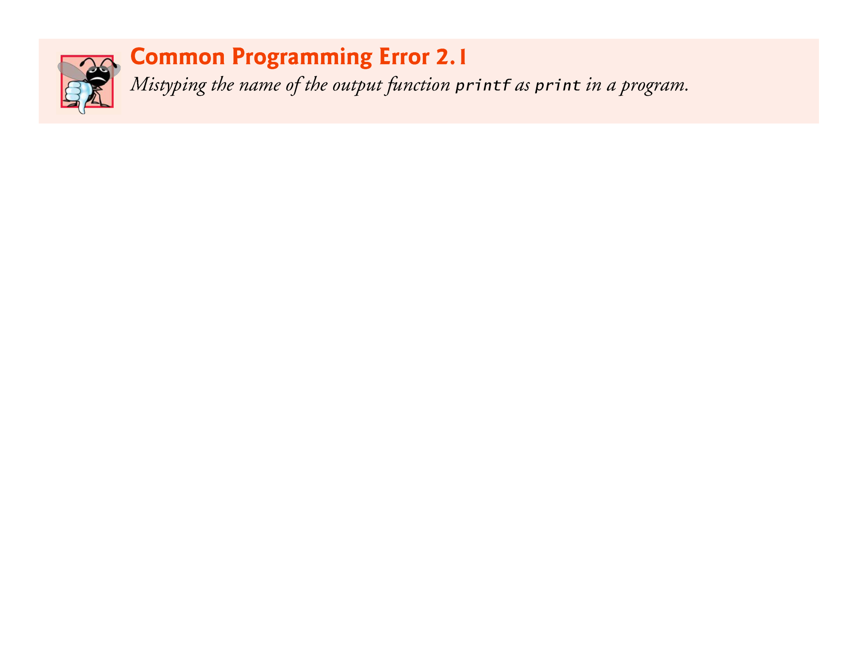

Slide 23
2.2 A Simple C Program: Printing a Line of Text (Cont.)
The Linker and Executables
Standard library functions like printf and scanf are not part of the C programming language.
For example, the compiler cannot find a spelling error in printf or scanf.
When the compiler compiles a printf statement, it merely provides space in the object program for a “call” to the library function.
But the compiler does not know where the library functions are—the linker does.
When the linker runs, it locates the library functions and inserts the proper calls to these library functions in the object program.

Slide 24
2.2 A Simple C Program: Printing a Line of Text (Cont.)
Now the object program is complete and ready to be executed.
For this reason, the linked program is called an executable.
If the function name is misspelled, it’s the linker that will spot the error, because it will not be able to match the name in the C program with the name of any known function in the libraries.

Slide 25
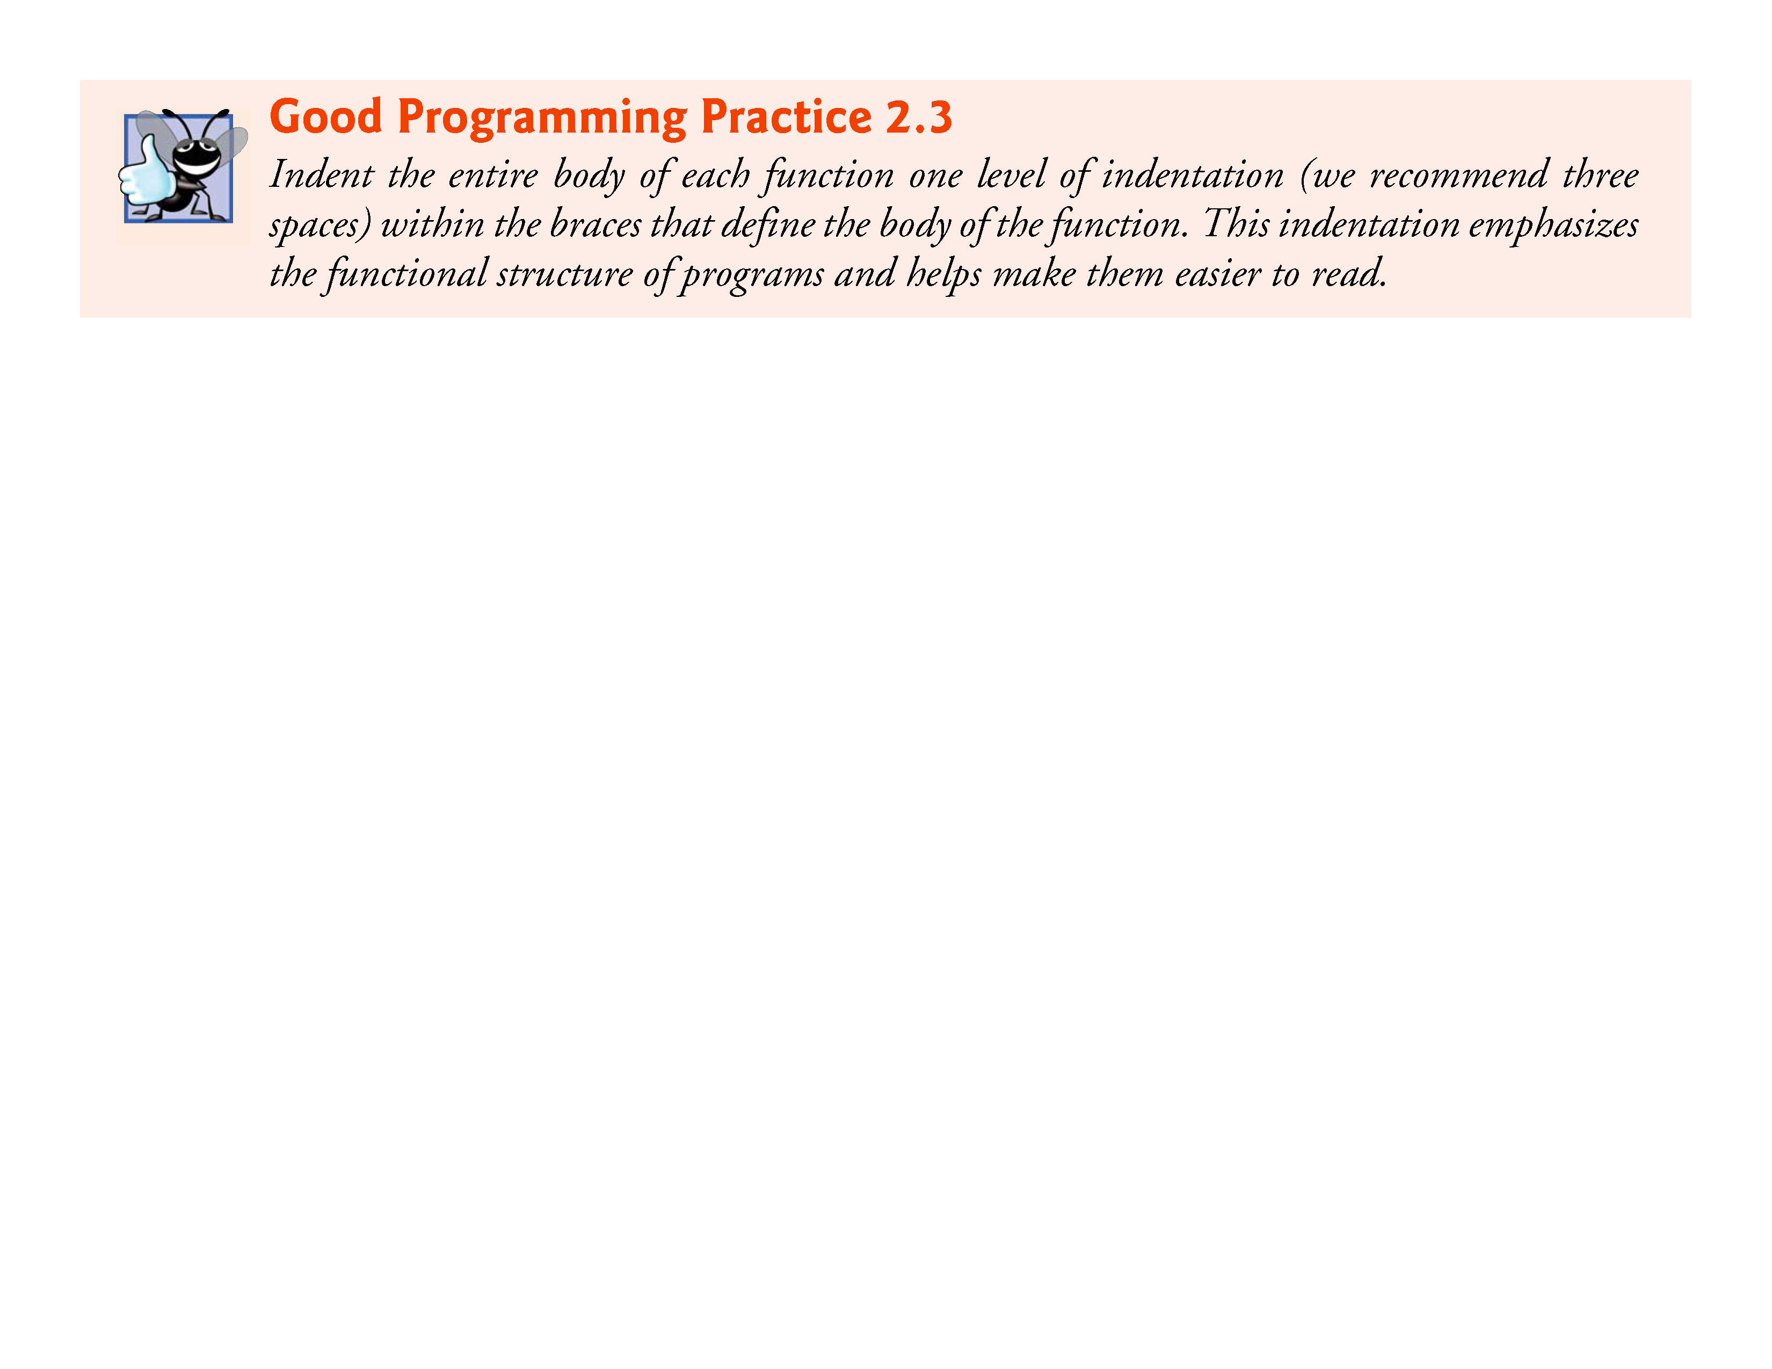

Slide 26
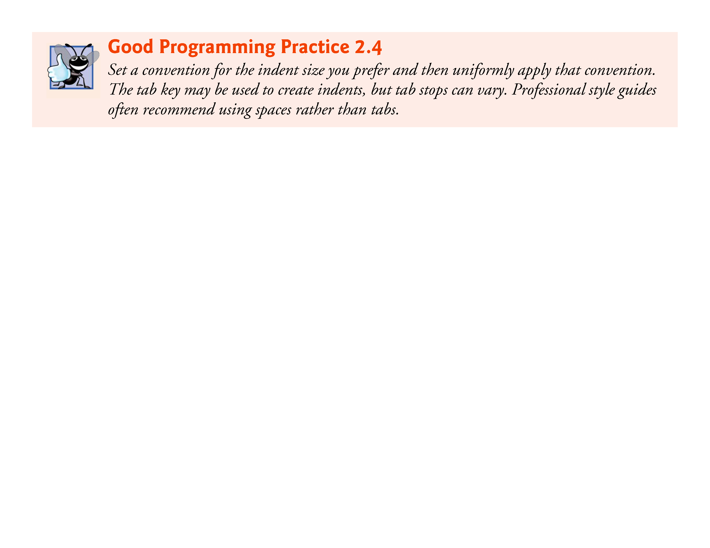

Slide 27
2.2 A Simple C Program: Printing a Line of Text (Cont.)
Using Multiple printfs
The printf function can print Welcome to C! several different ways.
For example, the program of Fig. 2.3 produces the same output as the program of Fig. 2.1.
This works because each printf resumes printing where the previous printf stopped printing.
The first printf prints Welcome followed by a space and the second printf begins printing on the same line immediately following the space.

Slide 28
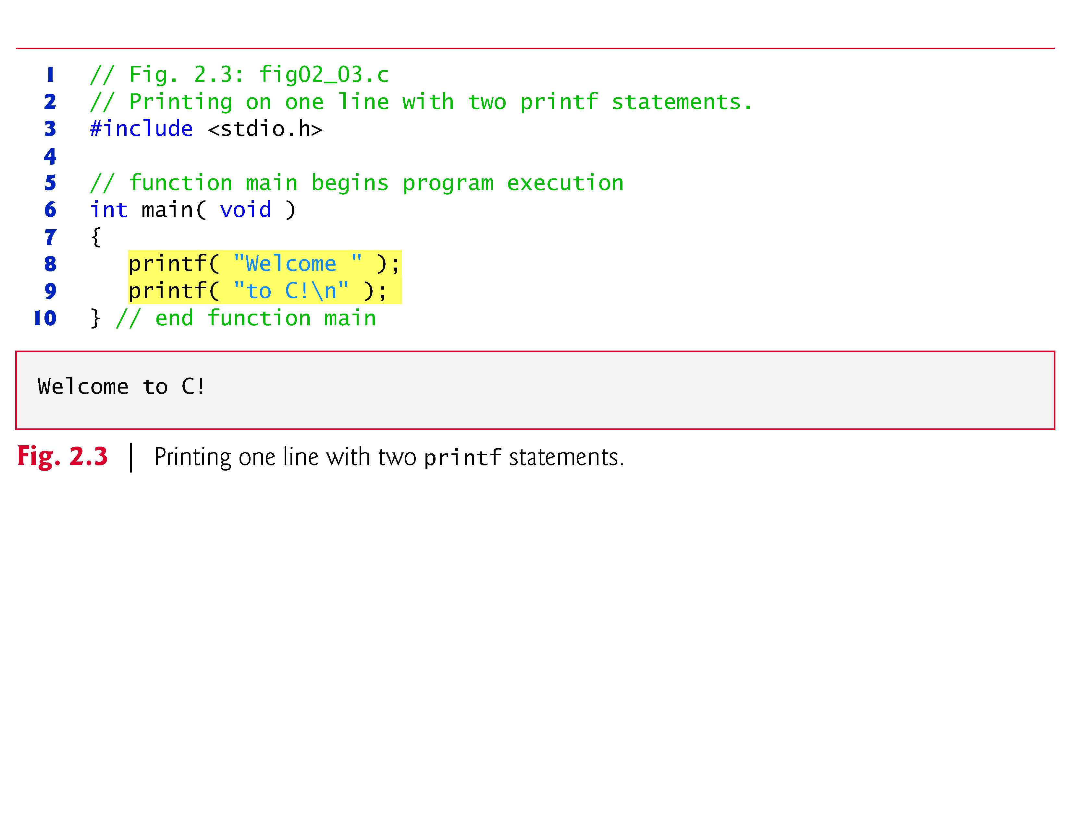

Slide 29
2.2 A Simple C Program: Printing a Line of Text (Cont.)
One printf can print several lines by using additional newline characters as in Fig. 2.4.
Each time the \n (newline) escape sequence is encountered, output continues at the beginning of the next line.

Slide 30
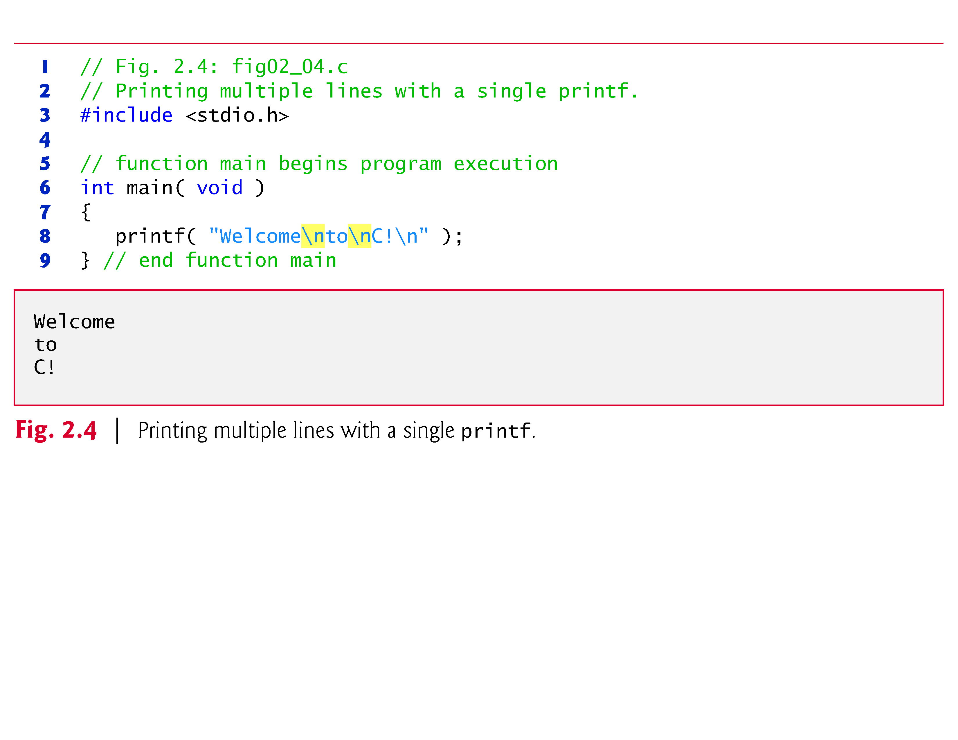

Slide 31
2.3 Another Simple C Program: Adding Two Integers
Our next program (fig. 2.5) uses the Standard Library function scanf to obtain two integers typed by a user at the keyboard, computes the sum of these values and prints the result using printf.
[In the input/output dialog of Fig. 2.5, we emphasize the numbers entered by the user in bold.]

Slide 32
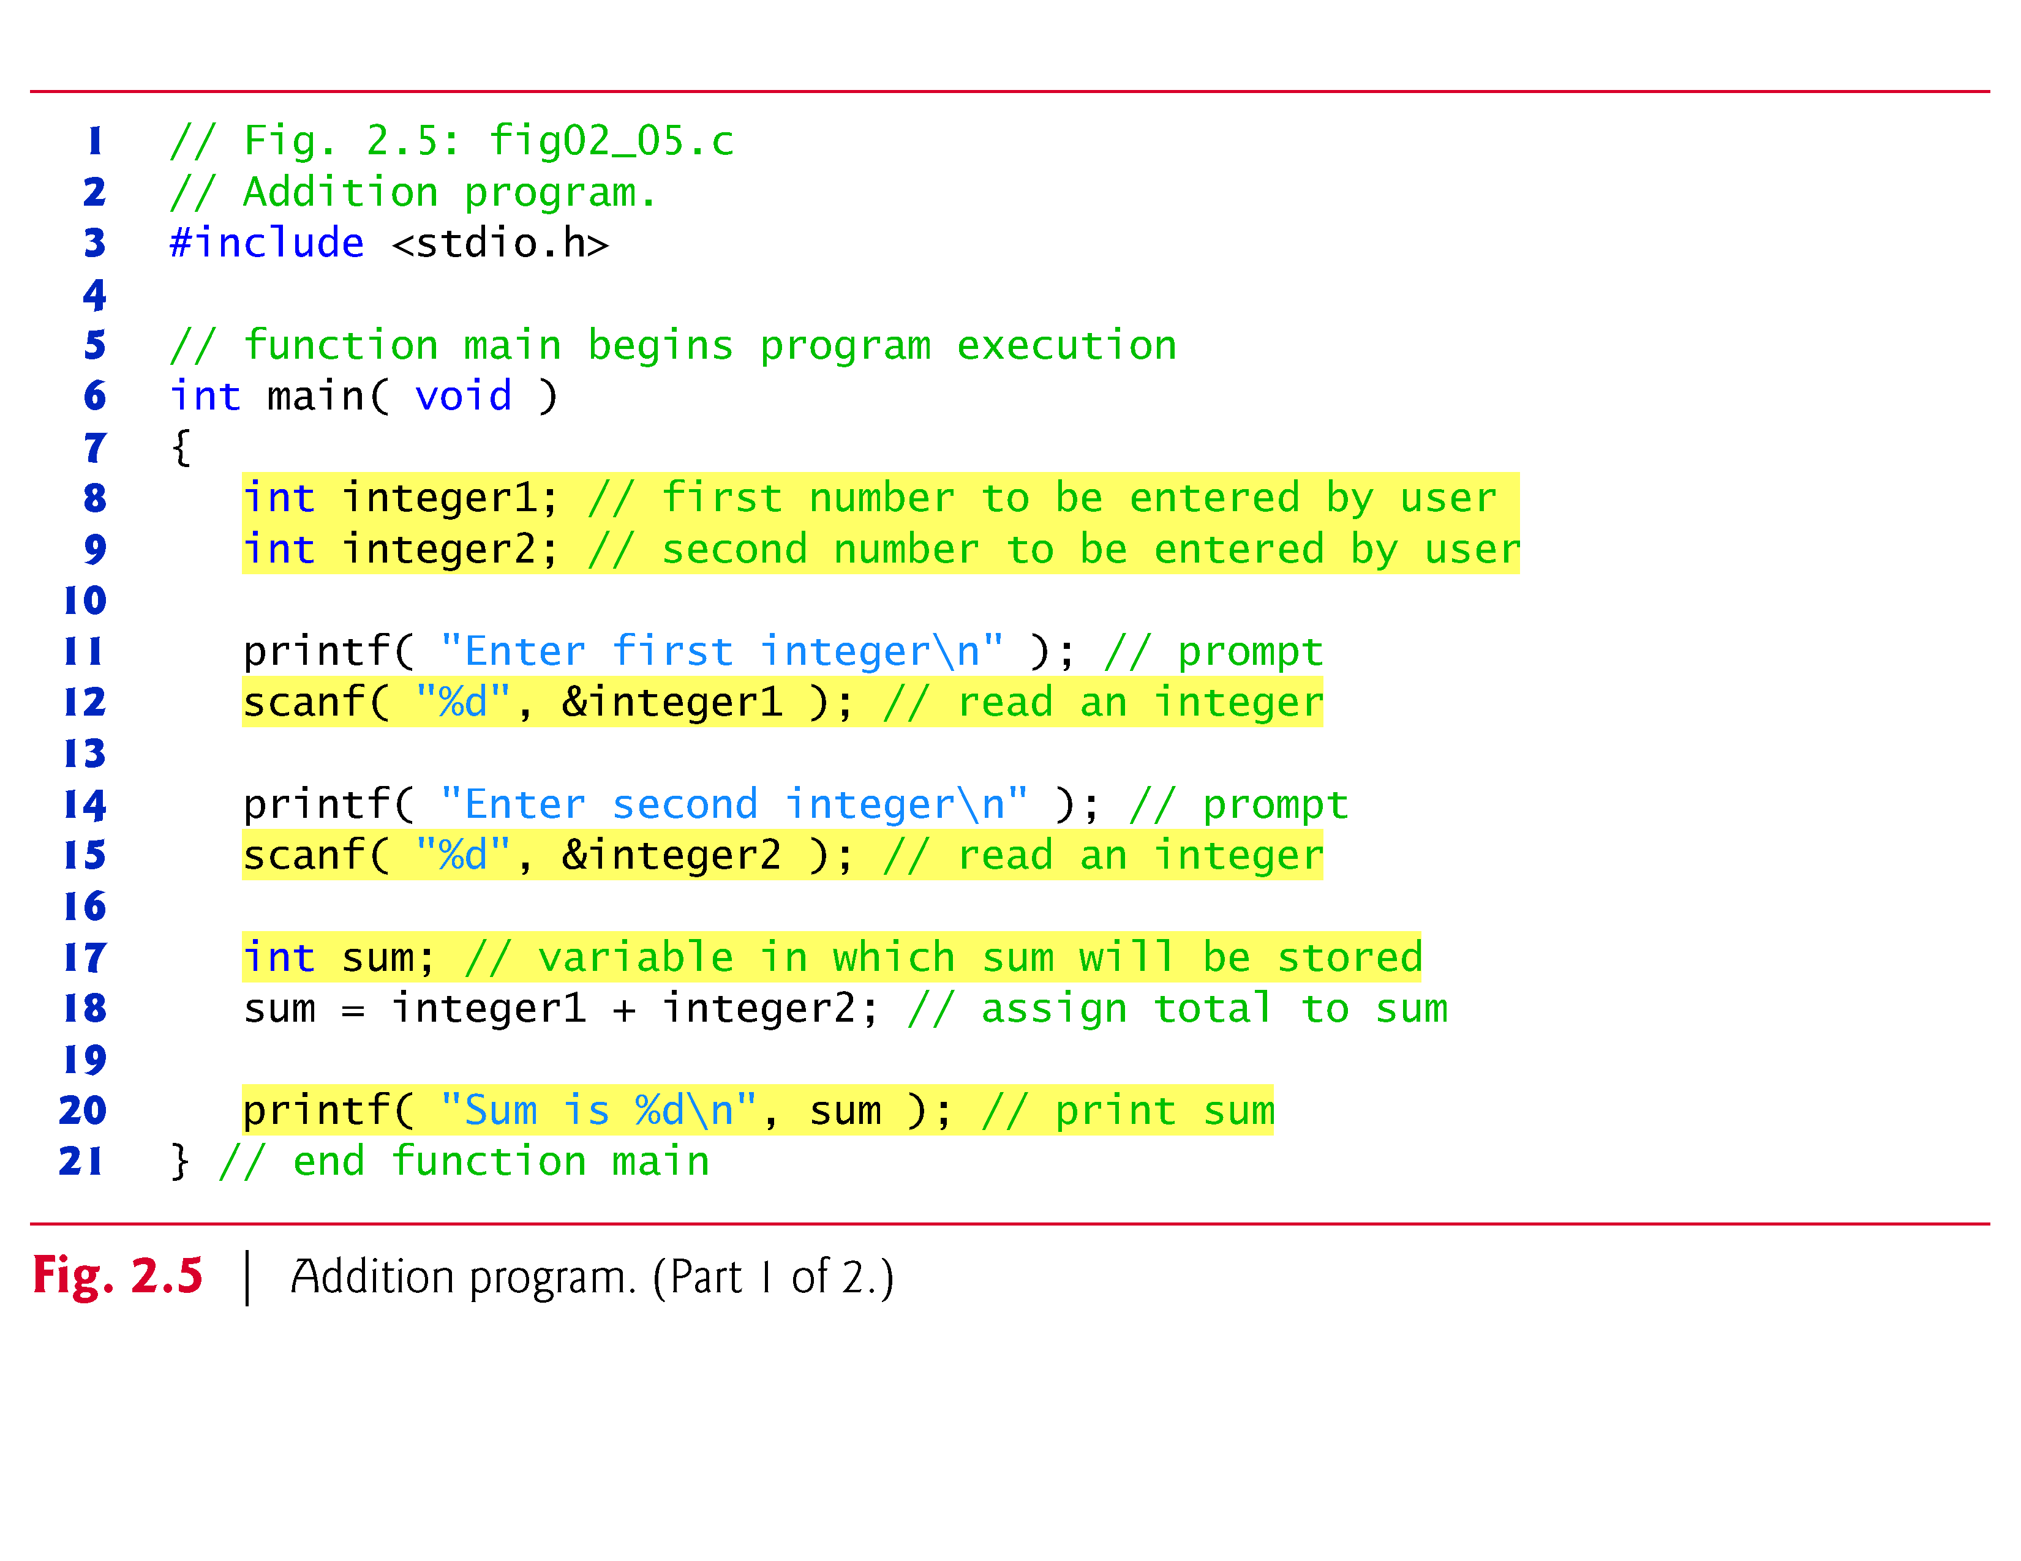

Slide 33
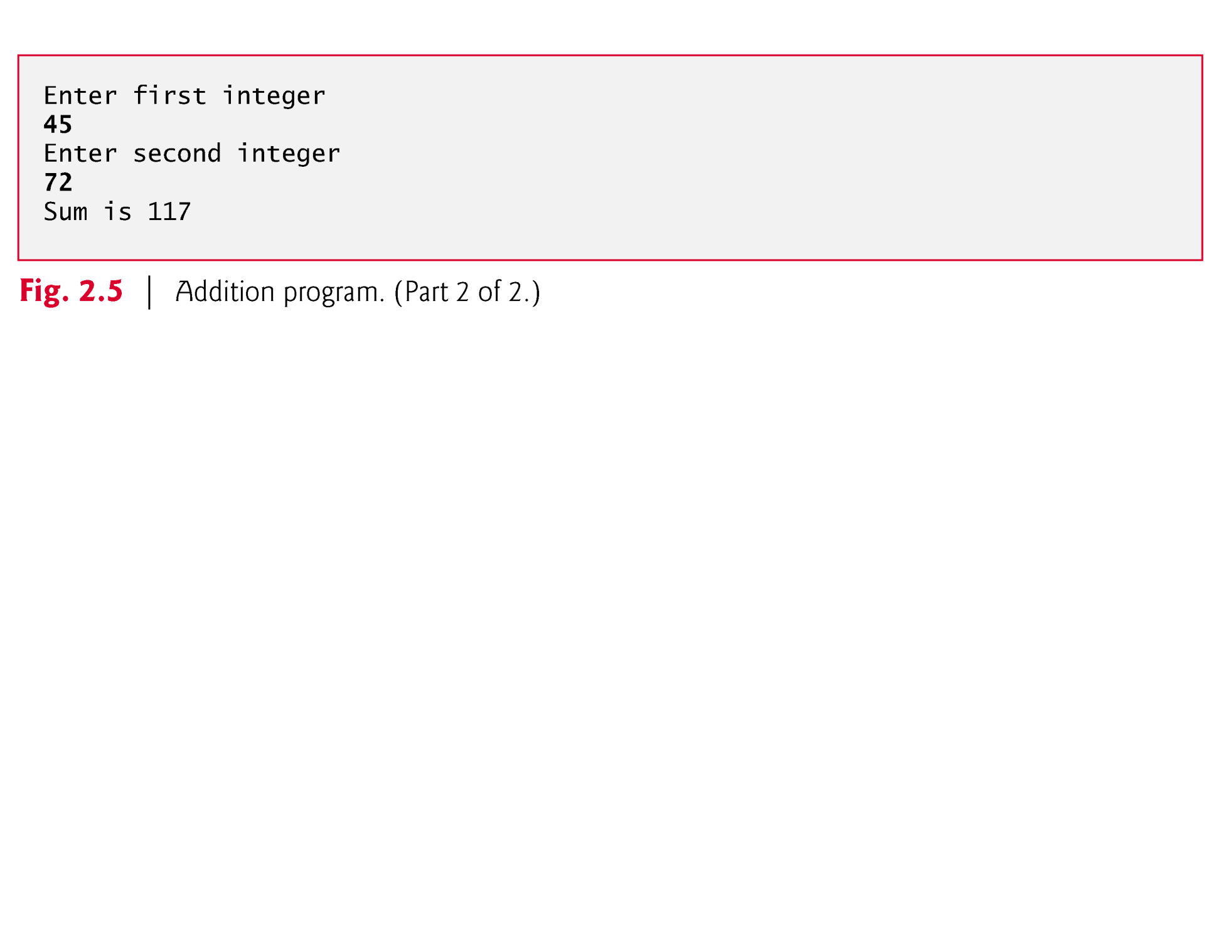

Slide 34
2.3 Another Simple C Program: Adding Two Integers (Cont.)
Variables and Variable Definitions
int integer1; // first number to be entered by user int integer2; // second number to be entered by user int sum; // variable in which sum will be stored
are definitions.
The names integer1, integer2 and sum are the names of variables—locations in memory where values can be stored for use by a program.
These definitions specify that the variables integer1, integer2 and sum are of type int, which means that they’ll hold integer values, i.e., whole numbers such as 7, –11, 0, 31914 and the like.

Slide 35
2.3 Another Simple C Program: Adding Two Integers (Cont.)
All variables must be defined with a name and a data type before they can be used in a program.
The preceding definitions could have been combined into a single definition statement as follows:
int integer1, integer2, sum;
but that would have made it difficult to describe the variables with corresponding comments

Slide 36
2.3 Another Simple C Program: Adding Two Integers (Cont.)
Identifiers and Case Sensitivity
A variable name in C is any valid identifier.
An identifier is a series of characters consisting of letters, digits and underscores (_) that does not begin with a digit.
C is case sensitive—uppercase and lowercase letters are different in C, so a1 and A1 are different identifiers.

Slide 37
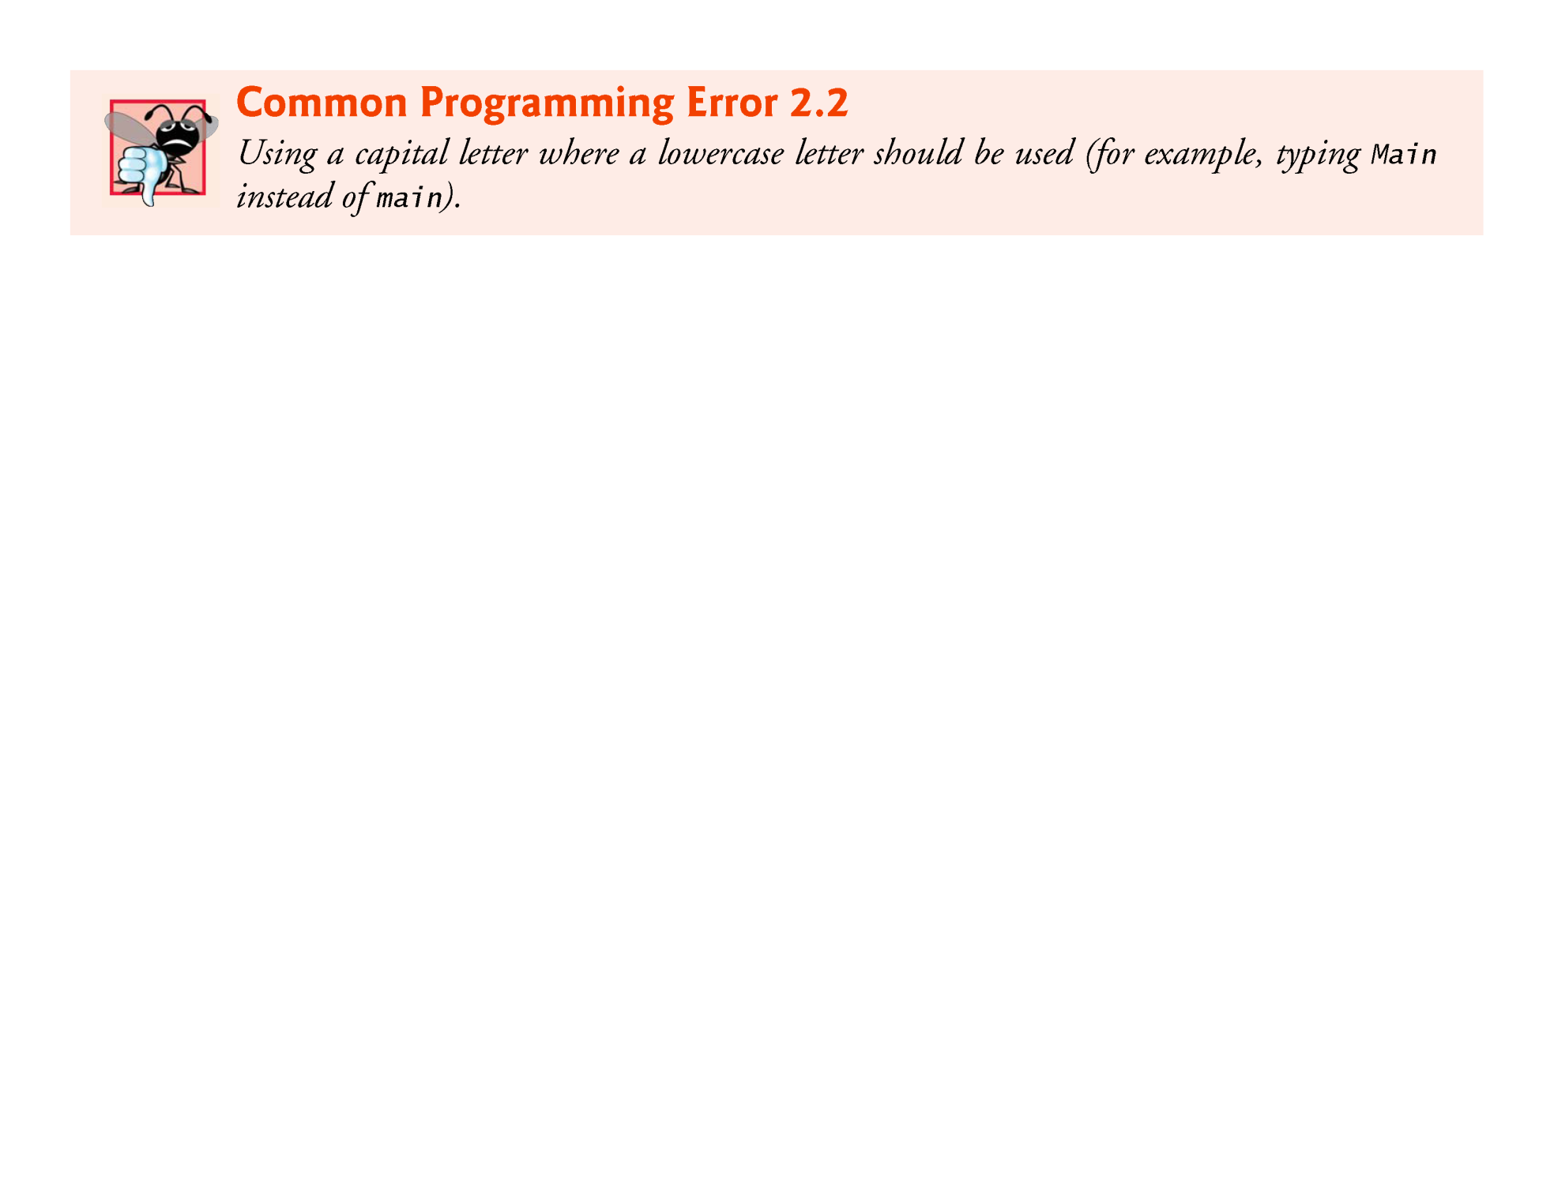

Slide 38
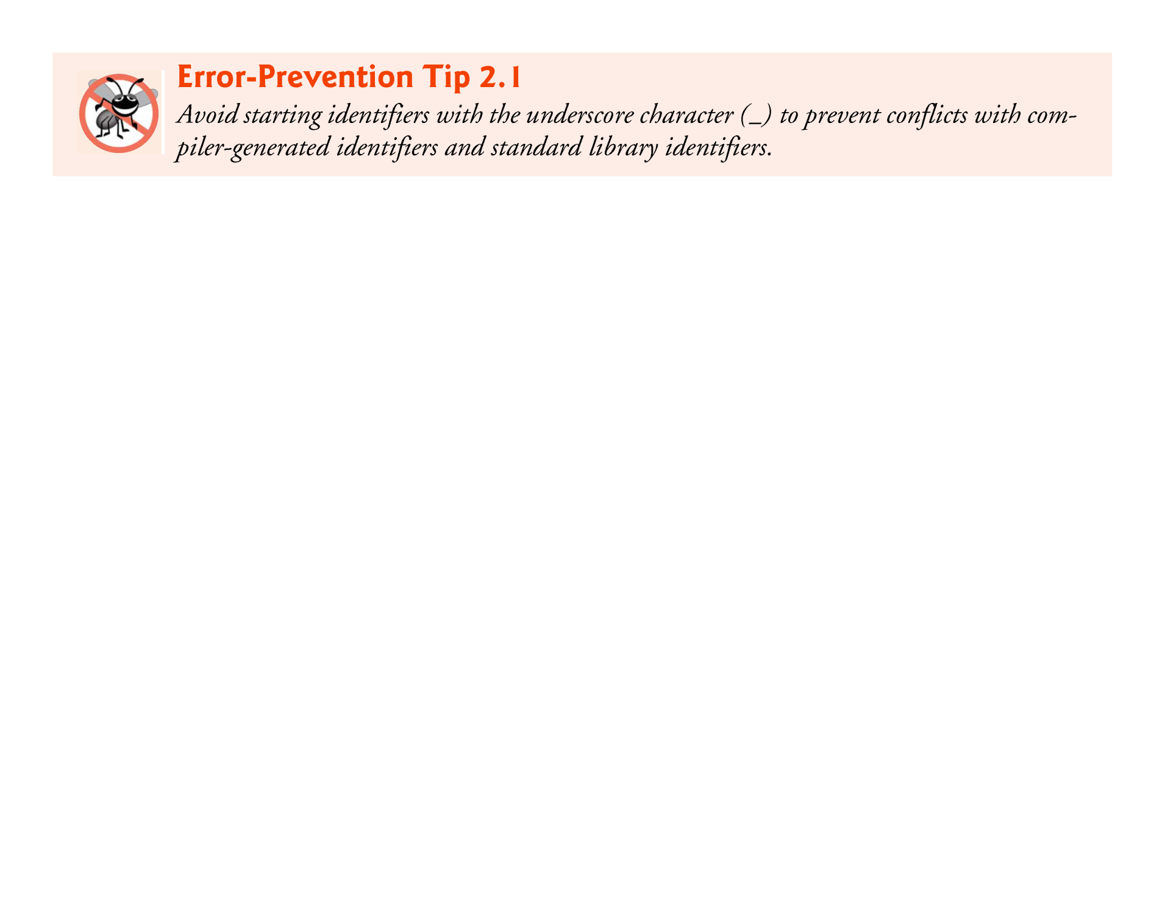

Slide 39
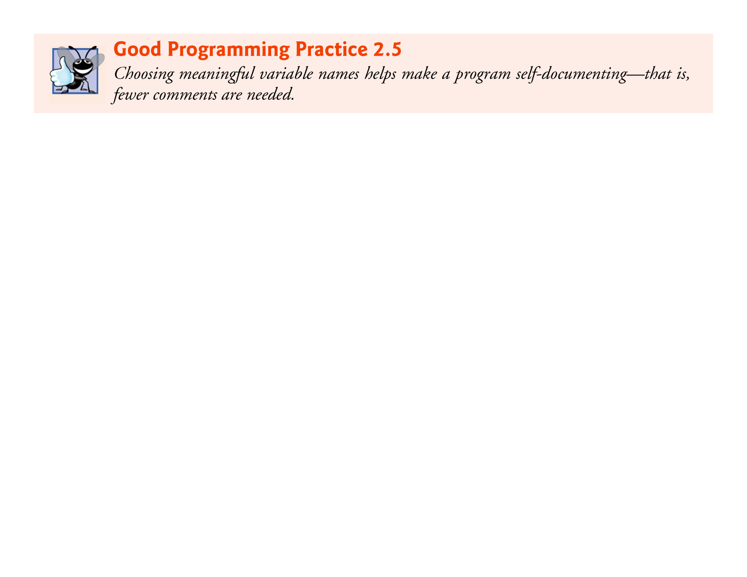

Slide 40
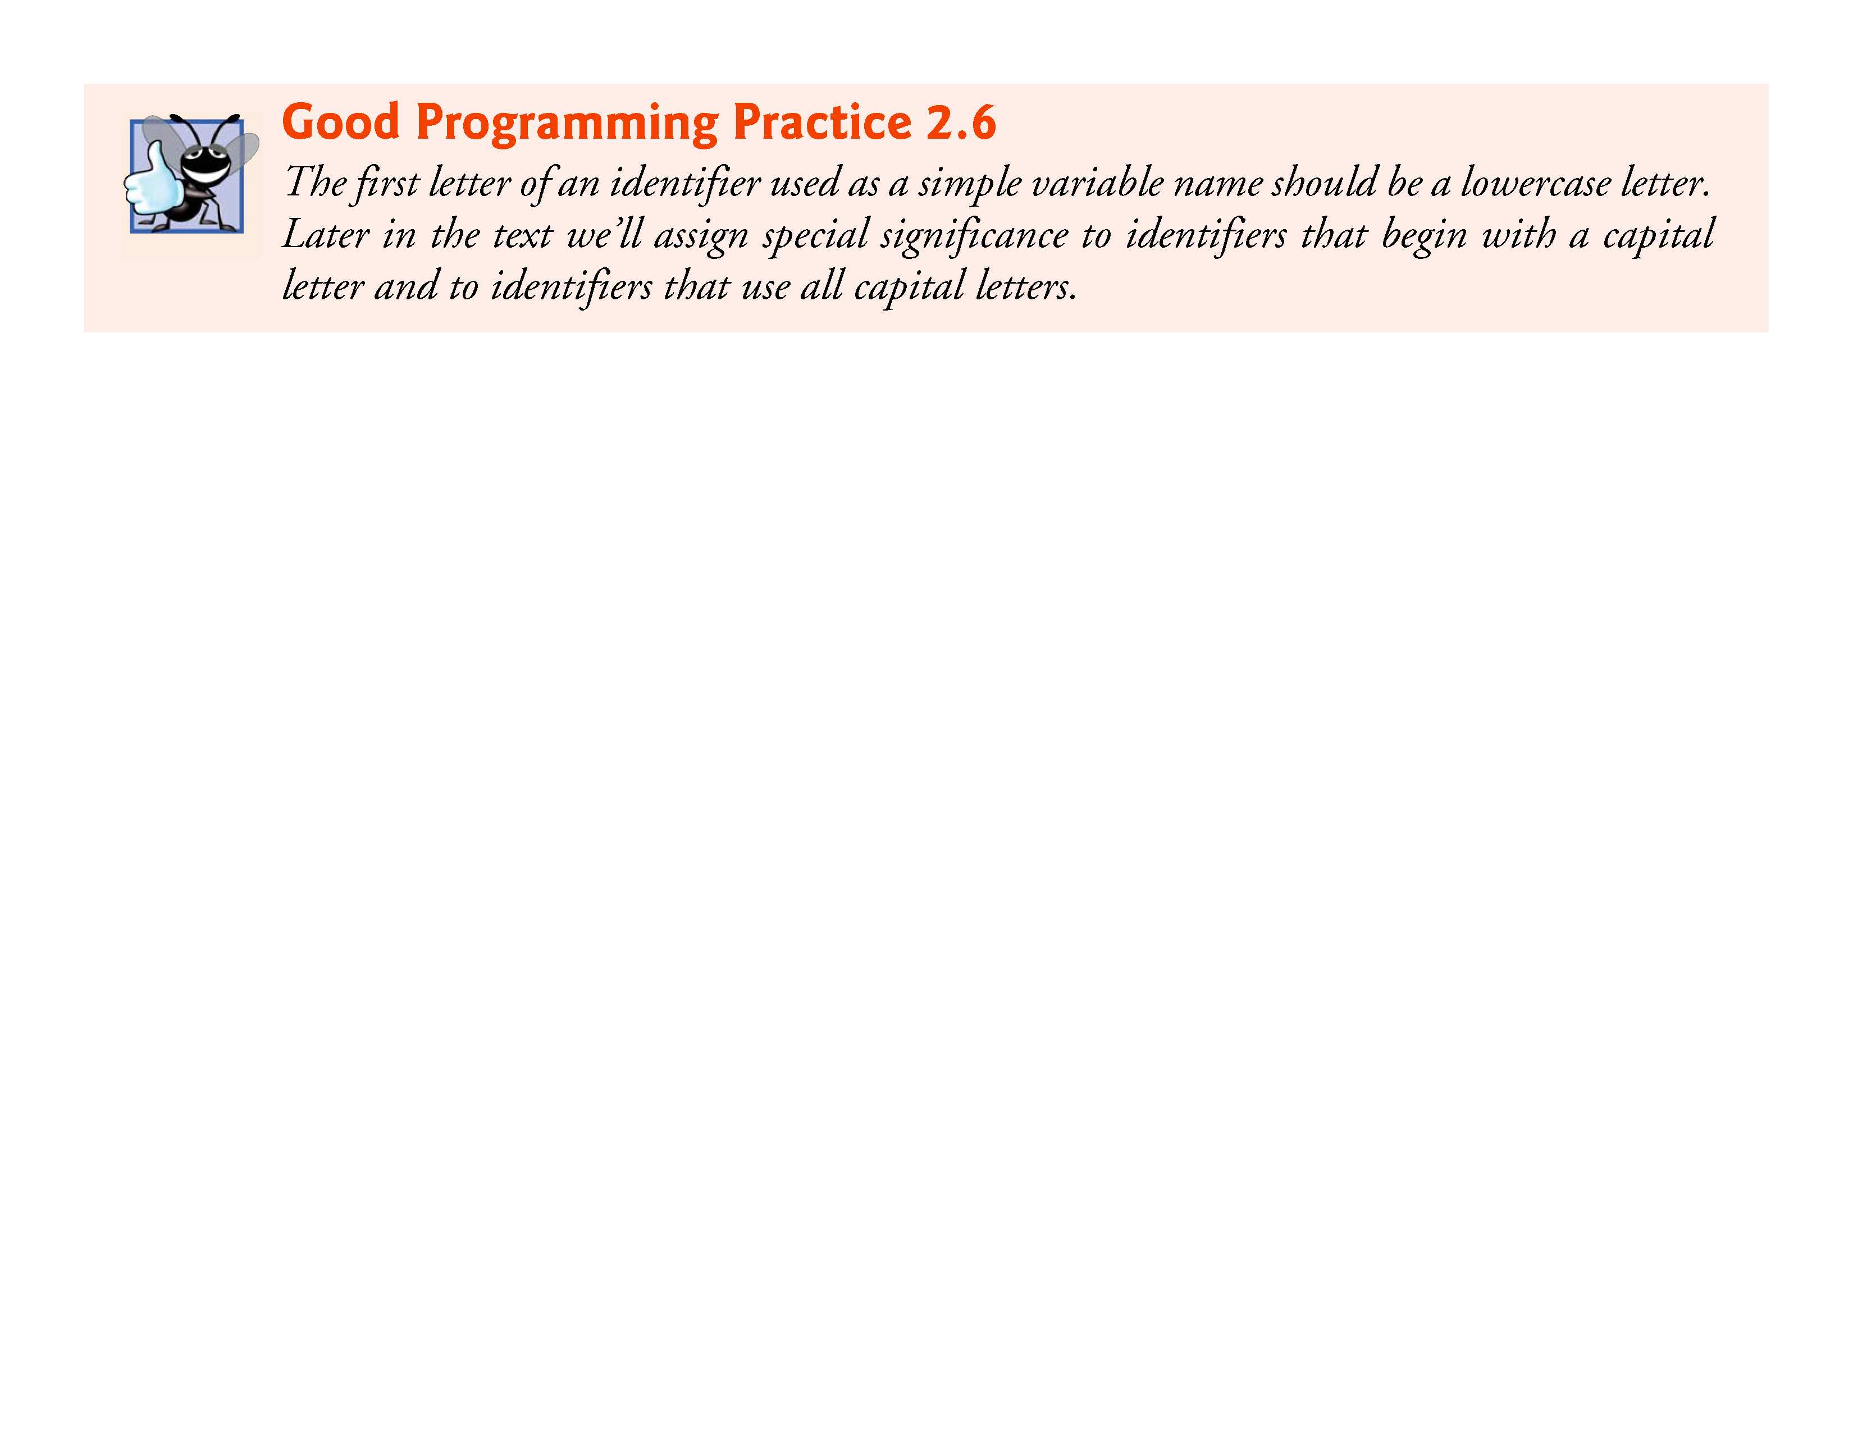

Slide 41
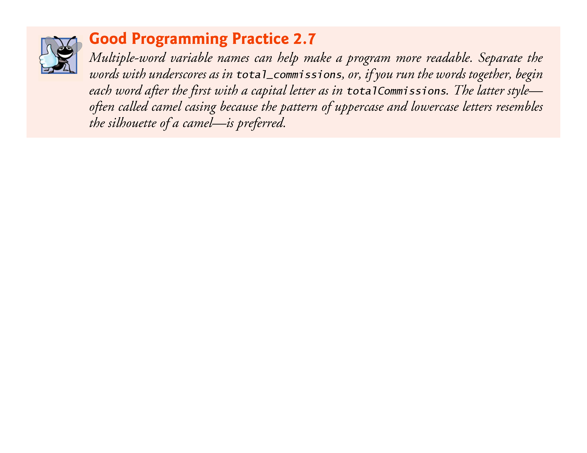

Slide 42
2.3 Another Simple C Program: Adding Two Integers (Cont.)
Prompting Messages
printf( "Enter first integer\n" ); // prompt
displays the literal “Enter first integer” and positions the cursor to the beginning of the next line.
This message is called a prompt because it tells the user to take a specific action.

Slide 43
2.3 Another Simple C Program: Adding Two Integers (Cont.)
The scanf Function and Formatted Inputs
The next statement
scanf( "%d", &integer1 ); // read an integer
uses scanf to obtain a value from the user.
The scanf function reads from the standard input, which is usually the keyboard.

Slide 44
2.3 Another Simple C Program: Adding Two Integers (Cont.)
This scanf has two arguments, "%d" and &integer1.
The first, the format control string, indicates the type of data that should be input by the user.
The %d conversion specifier indicates that the data should be an integer (the letter d stands for “decimal integer”).
The % in this context is treated by scanf (and printf as we’ll see) as a special character that begins a conversion specifier.
The second argument of scanf begins with an ampersand (&)—called the address operator in C—followed by the variable name.

Slide 45
2.3 Another Simple C Program: Adding Two Integers (Cont.)
The &, when combined with the variable name, tells scanf the location (or address) in memory at which the variable integer1 is stored.
The computer then stores the value that the user enters for integer1 at that location.
The use of ampersand (&) is often confusing to novice programmers or to people who have programmed in other languages that do not require this notation.
For now, just remember to precede each variable in every call to scanf with an ampersand.

Slide 46
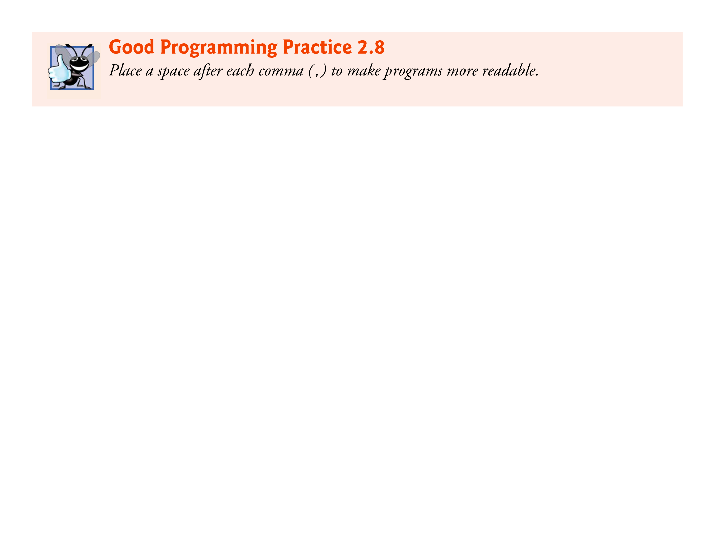

Slide 47
2.3 Another Simple C Program: Adding Two Integers (Cont.)
When the computer executes the preceding scanf, it waits for the user to enter a value for variable integer1.
The user responds by typing an integer, then pressing the Enter key to send the number to the computer.
The computer then assigns this number, or value, to the variable integer1.
Any subsequent references to integer1 in this program will use this same value.
Functions printf and scanf facilitate interaction between the user and the computer.
Because this interaction resembles a dialogue, it’s often called interactive computing.

Slide 48
2.3 Another Simple C Program: Adding Two Integers (Cont.)
printf( "Enter second integer\n" ); // prompt
displays the message Enter second integer on the screen, then positions the cursor to the beginning of the next line.
This printf also prompts the user to take action.
scanf( "%d", &integer2 ); // read an integer
obtains a value for variable integer2 from the user.

Slide 49
2.3 Another Simple C Program: Adding Two Integers (Cont.)
Assignment Statement
The assignment statement
sum = integer1 + integer2; // assign total to sum
calculates the total of variables integer1 and integer2 and assigns the result to variable sum using the assignment operator =.
The statement is read as, “sum gets the value of integer1 + integer2.” Most calculations are performed in assignments.
The = operator and the + operator are called binary operators because each has two operands.
The + operator’s two operands are integer1 and integer2.
The = operator’s two operands are sum and the value of the expression integer1 + integer2.

Slide 50


Slide 51
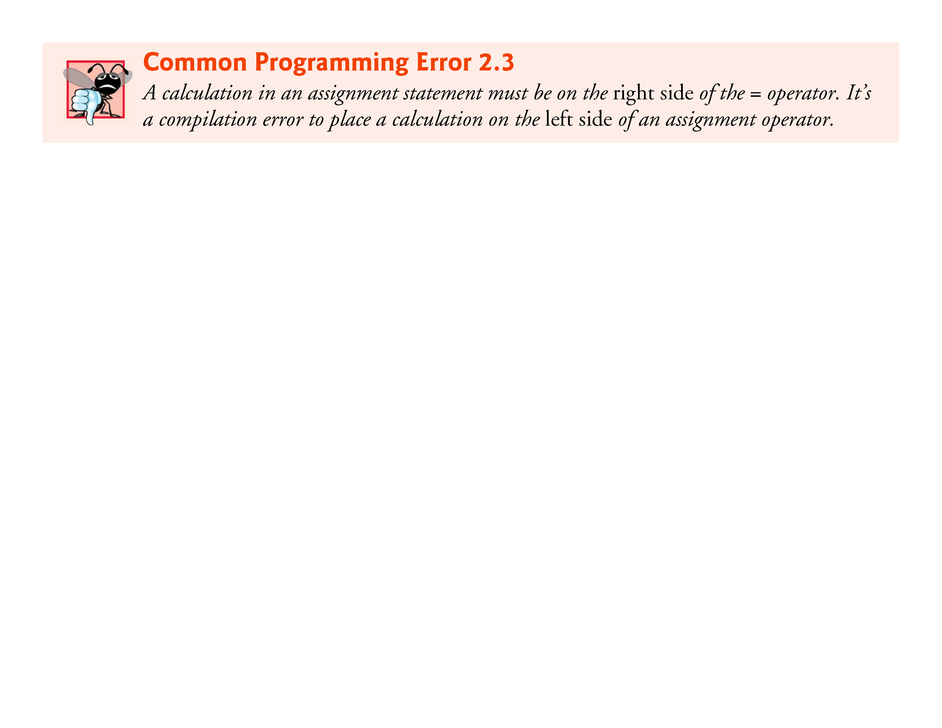

Slide 52
2.3 Another Simple C Program: Adding Two Integers (Cont.)
Printing with a Format Control String
printf( "Sum is %d\n", sum ); // print sum
calls function printf to print the literal Sum is followed by the numerical value of variable sum on the screen.
This printf has two arguments, "Sum is %d\n" and sum.
The first argument is the format control string.
It contains some literal characters to be displayed, and it contains the conversion specifier %d indicating that an integer will be printed.
The second argument specifies the value to be printed.
Notice that the conversion specifier for an integer is the same in both printf and scanf.

Slide 53
2.3 Another Simple C Program: Adding Two Integers (Cont.)
Calculations in printf Statements
We could have combined the previous two statements into the statement
printf( "Sum is %d\n", integer1 + integer2 );
The right brace, }, at line 21 indicates that the end of function main has been reached.

Slide 54
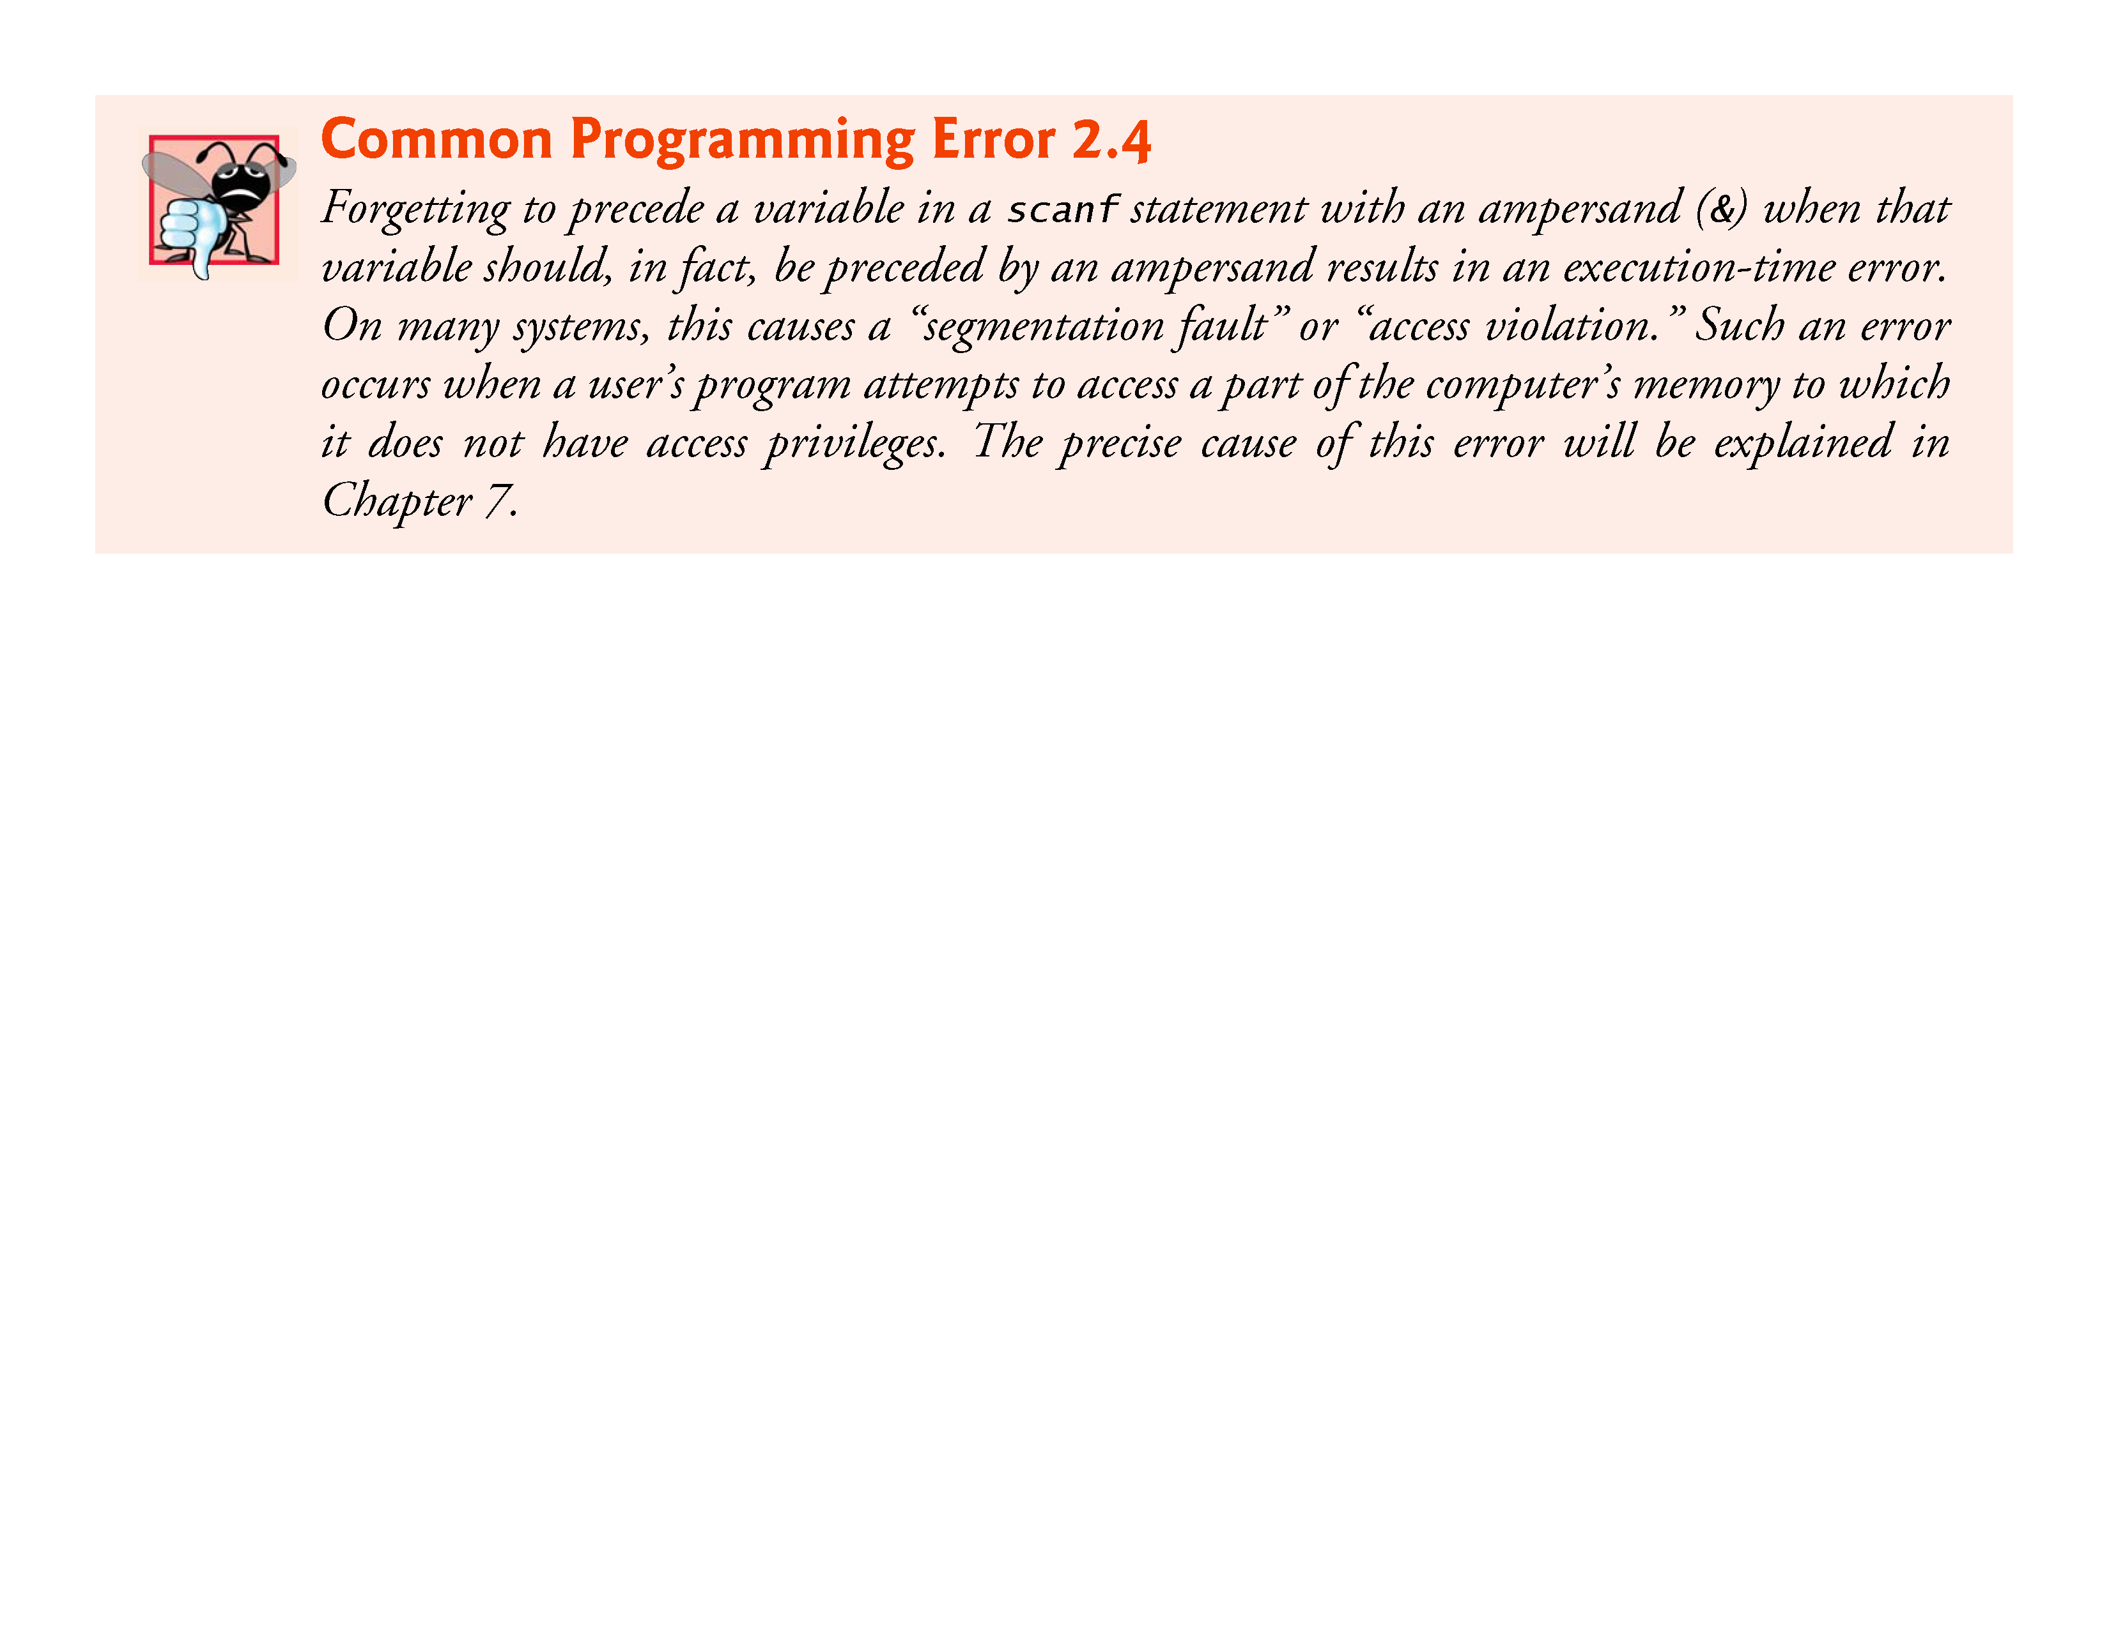

Slide 55
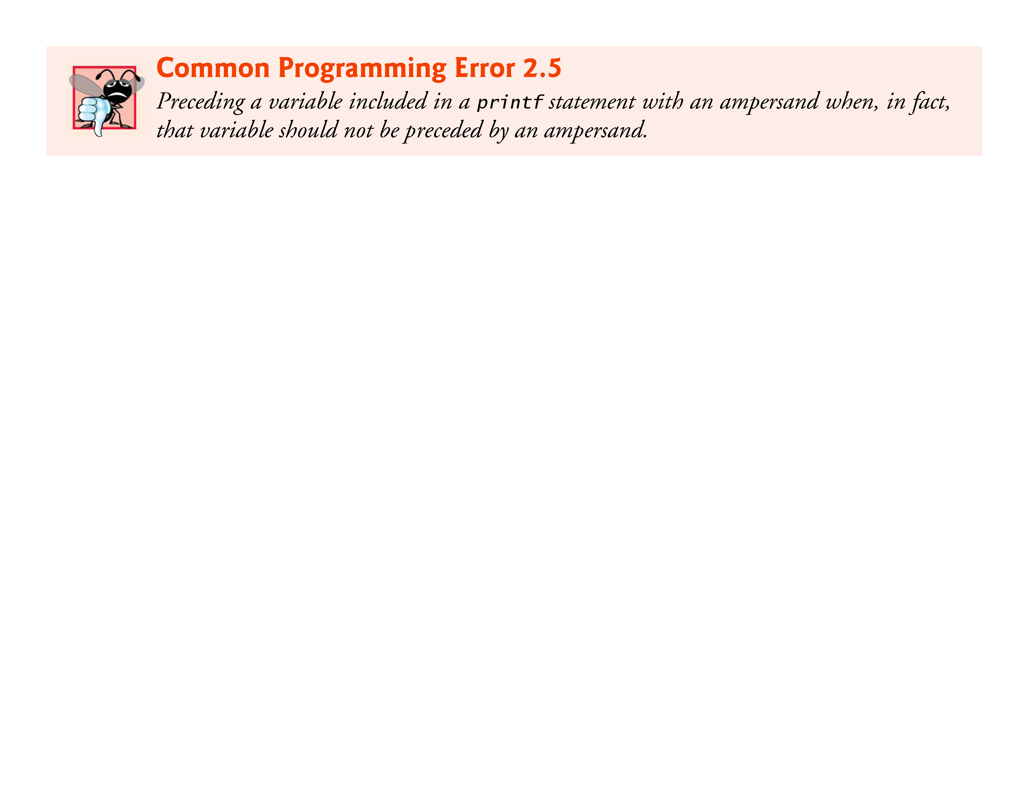

Slide 56
2.4 Memory Concepts
Variable names such as integer1, integer2 and sum actually correspond to locations in the computer’s memory.
Every variable has a name, a type and a value.
In the addition program of Fig. 2.5, when the statement
scanf( "%d", &integer1 ); // read an integer
is executed, the value entered by the user is placed into a memory location to which the name integer1 has been assigned.
Suppose the user enters the number 45 as the value for integer1.
The computer will place 45 into location integer1 as shown in Fig. 2.6.

Slide 57
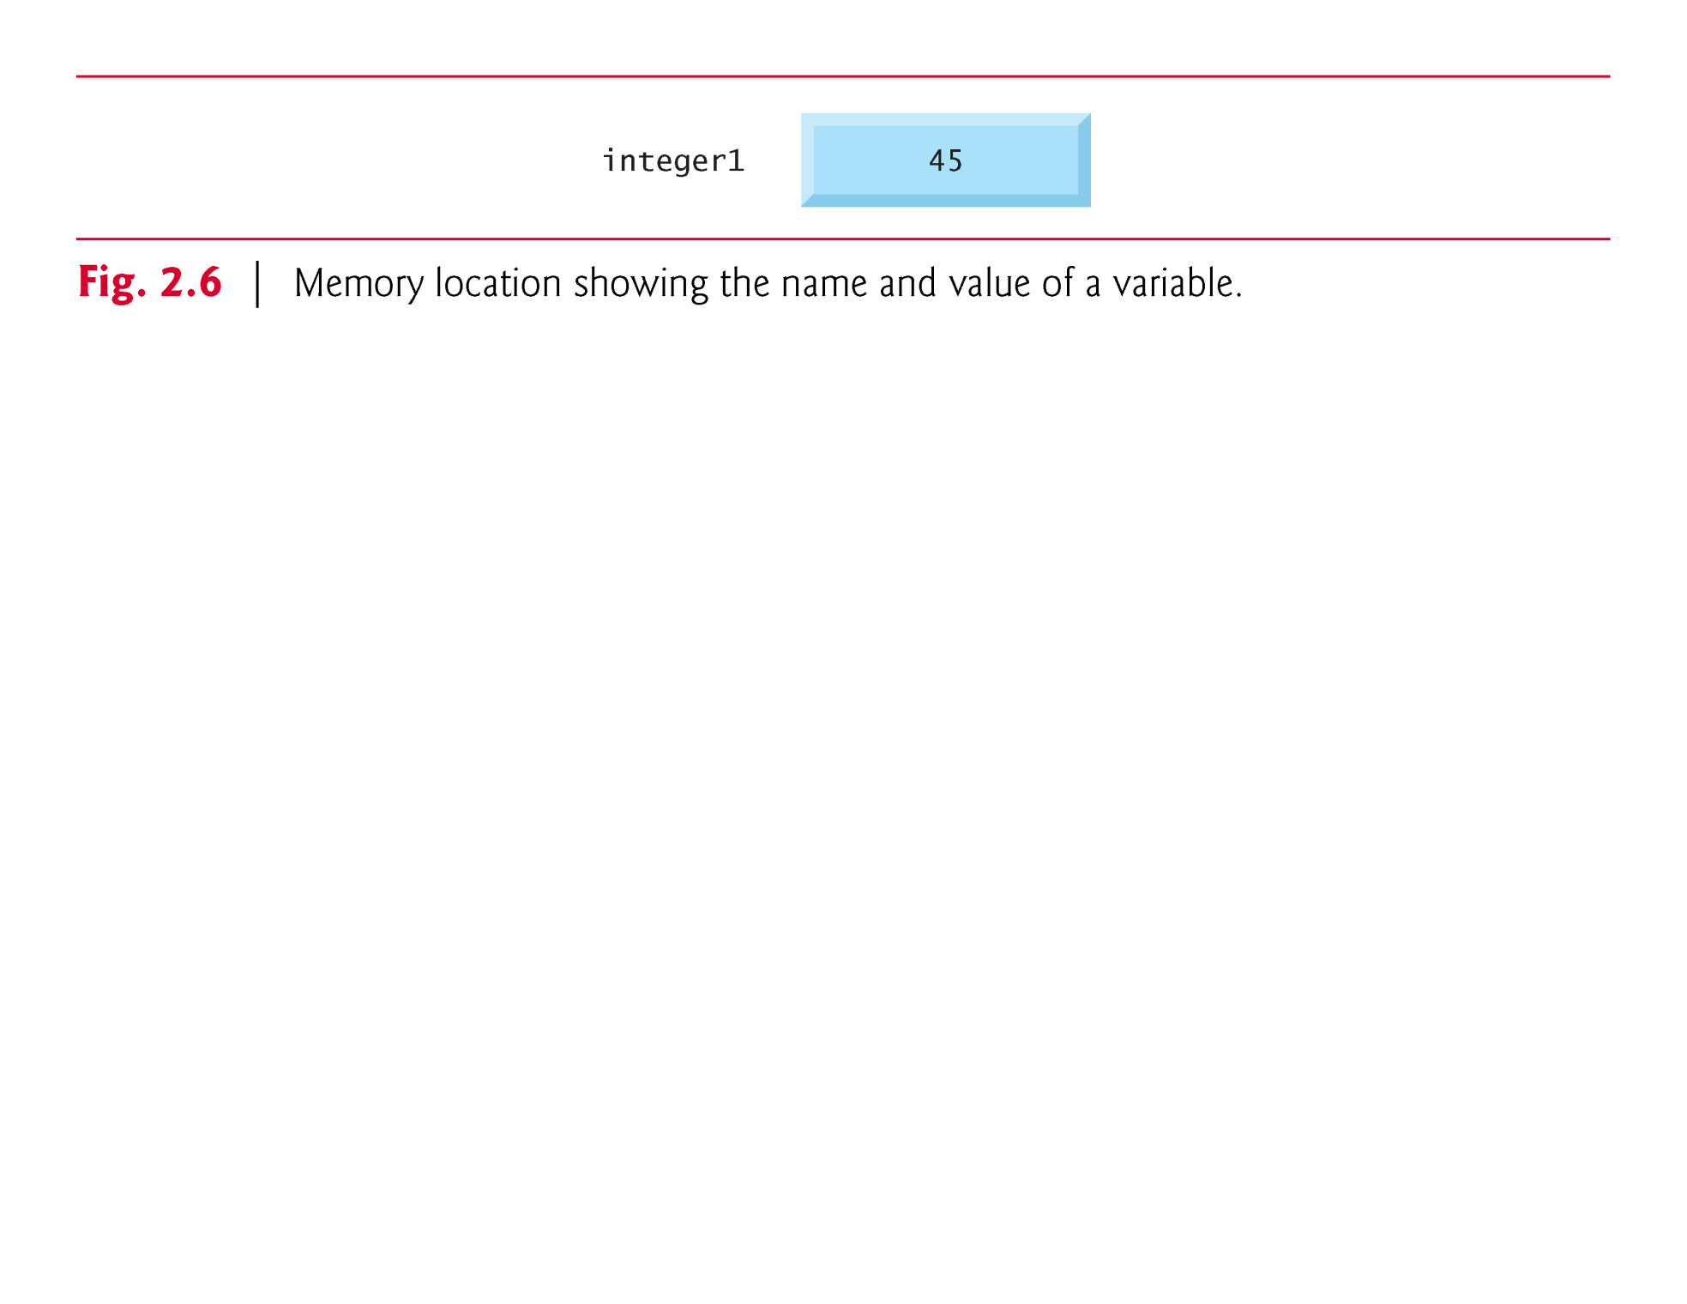

Slide 58
2.4 Memory Concepts (Cont.)
Whenever a value is placed in a memory location, the value replaces the previous value in that location; thus, this process is said to be destructive.
When the statement
scanf( "%d", &integer2 ); // read an integer
executes, suppose the user enters the value 72.
This value is placed into location integer2, and memory appears as in Fig. 2.7.
These locations are not necessarily adjacent in memory.

Slide 59
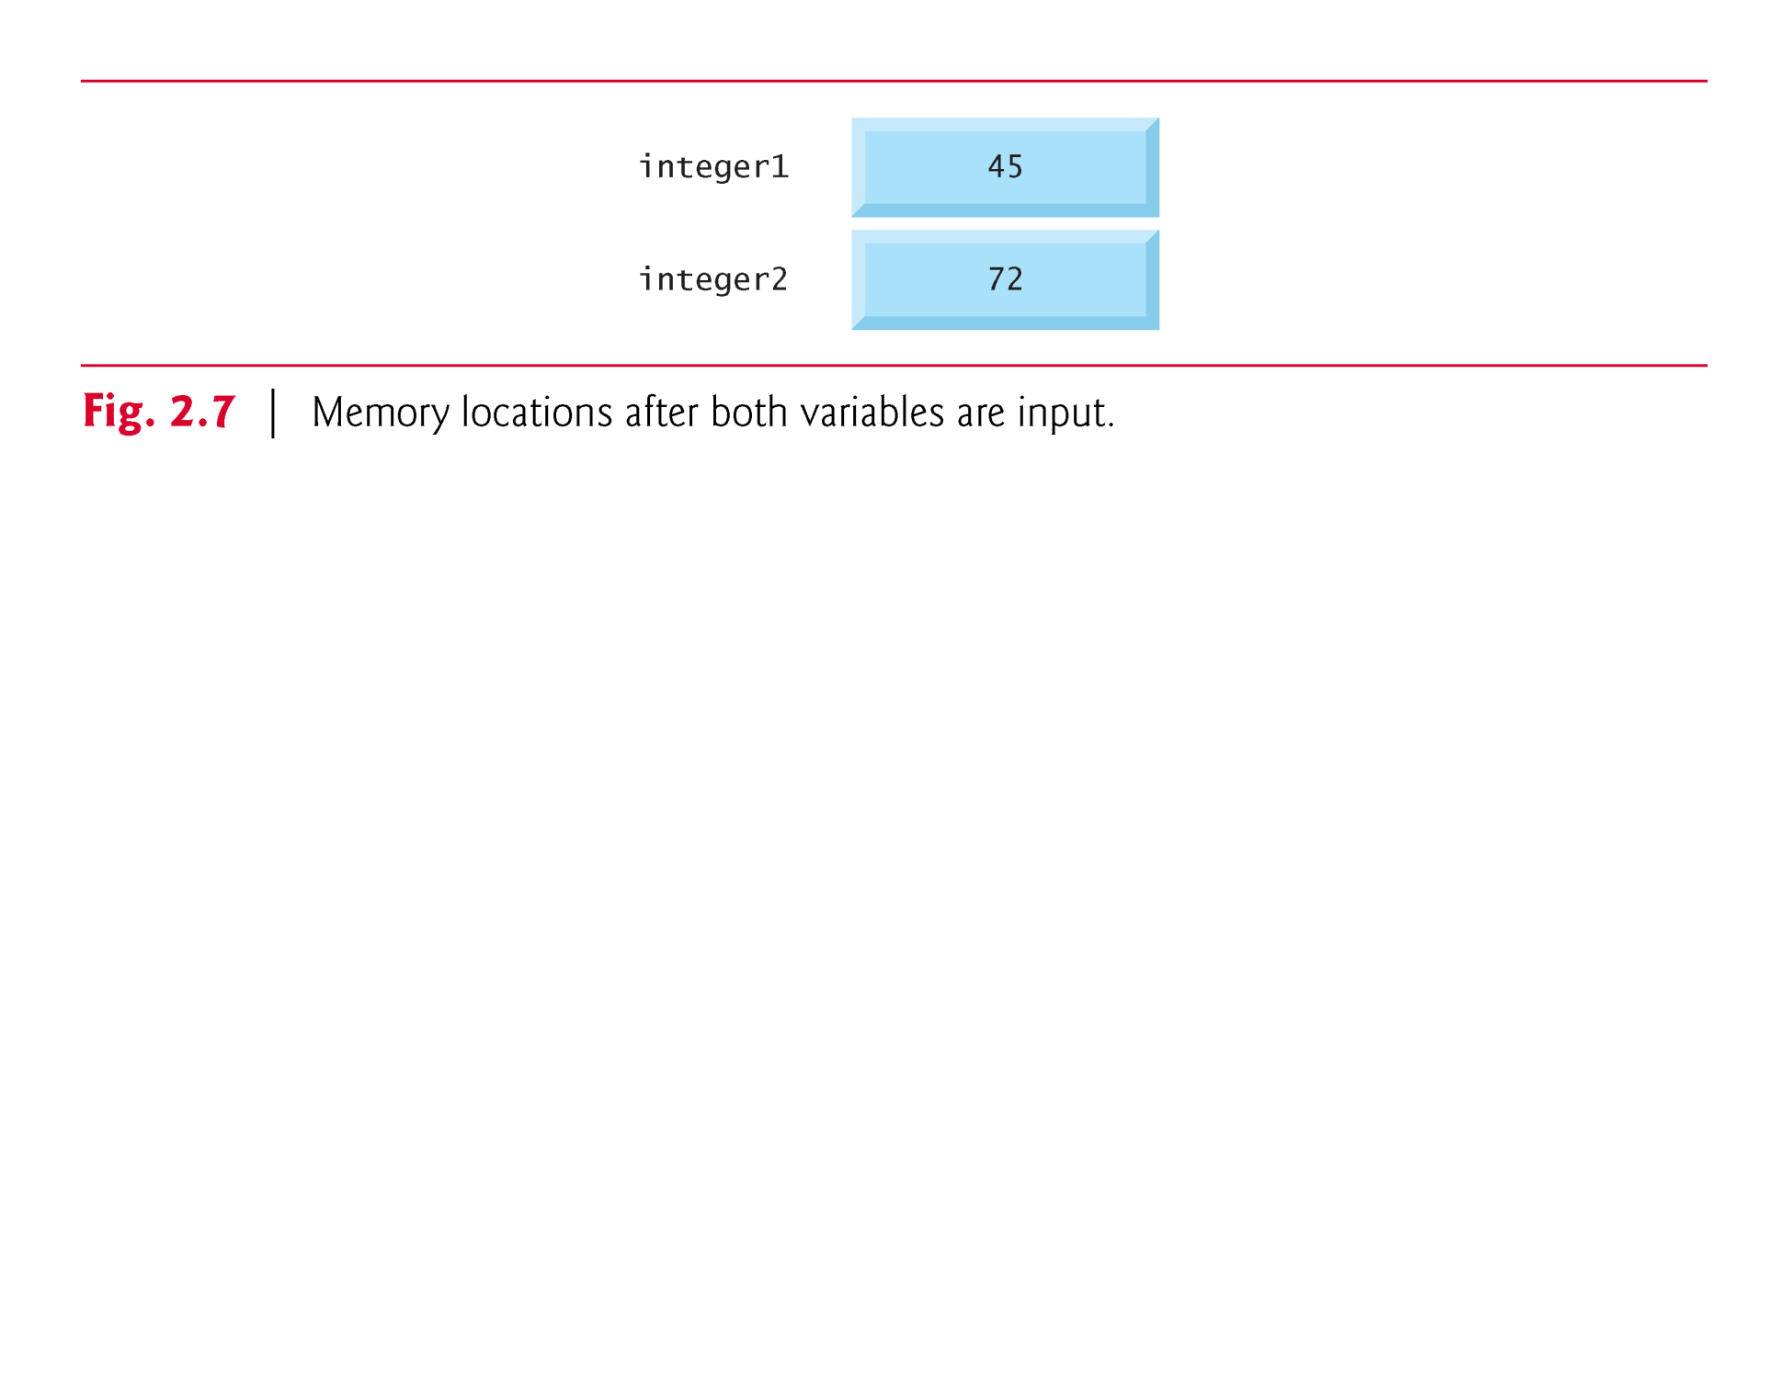

Slide 60
2.4 Memory Concepts (Cont.)
Once the program has obtained values for integer1 and integer2, it adds these values and places the total into variable sum.
sum = integer1 + integer2; // assign total to sum
replaces whatever value was stored in sum.

Slide 61
2.4 Memory Concepts (Cont.)
This occurs when the calculated total of integer1 and integer2 is placed into location sum (destroying the value already in sum).
After sum is calculated, memory appears as in Fig. 2.8.
The values of integer1 and integer2 appear exactly as they did before they were used in the calculation.

Slide 62
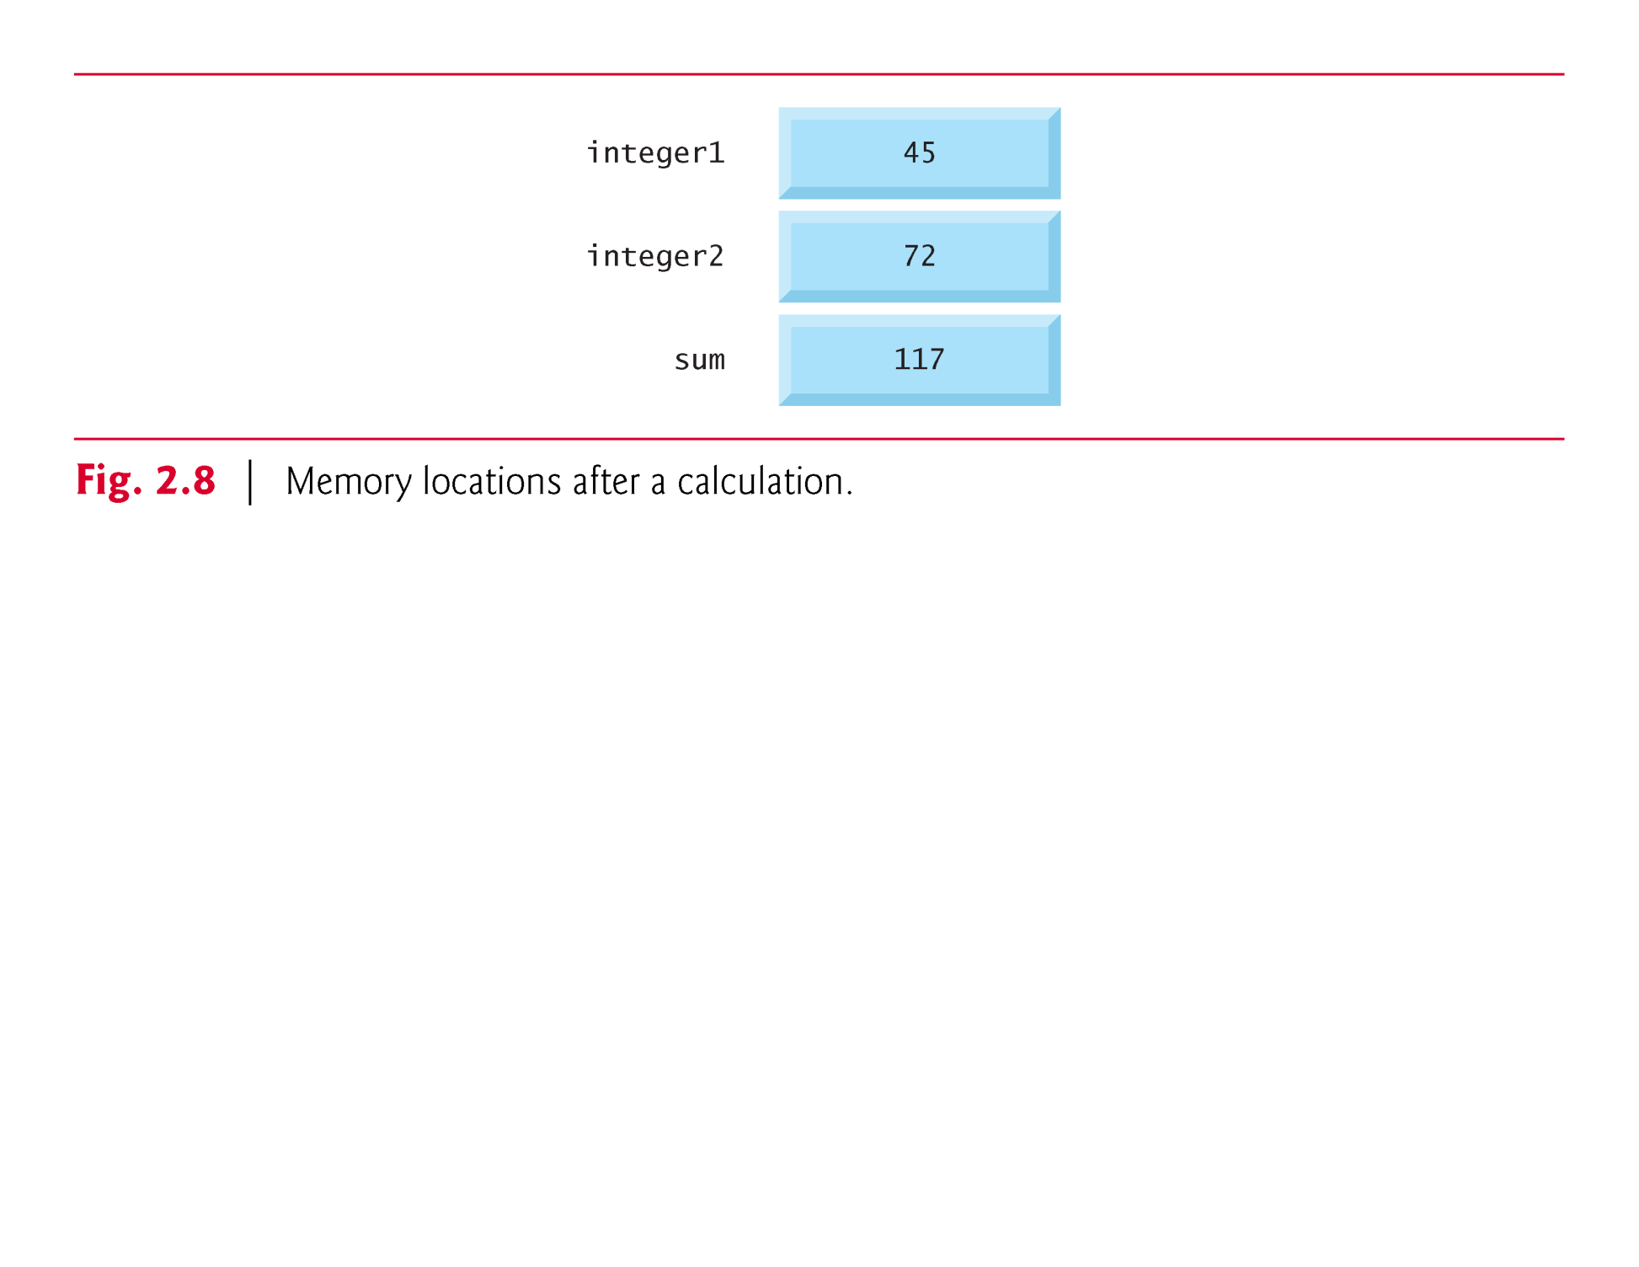

Slide 63
2.4 Memory Concepts (Cont.)
They were used, but not destroyed, as the computer performed the calculation.
Thus, when a value is read from a memory location, the process is said to be nondestructive.

Slide 64
2.5 Arithmetic in C
Most C programs perform calculations using the C arithmetic operators (Fig. 2.9).
The asterisk (*) indicates multiplication and the percent sign (%) denotes the remainder operator, which is introduced below.
In algebra, to multiply a times b, we simply place these single-letter variable names side by side as in ab.
In C, however, if we were to do this, ab would be interpreted as a single, two-letter name (or identifier).
Therefore, C requires that multiplication be explicitly denoted by using the * operator as in a * b.
The arithmetic operators are all binary operators.
For example, the expression 3 + 7 contains the binary operator + and the operands 3 and 7.

Slide 65
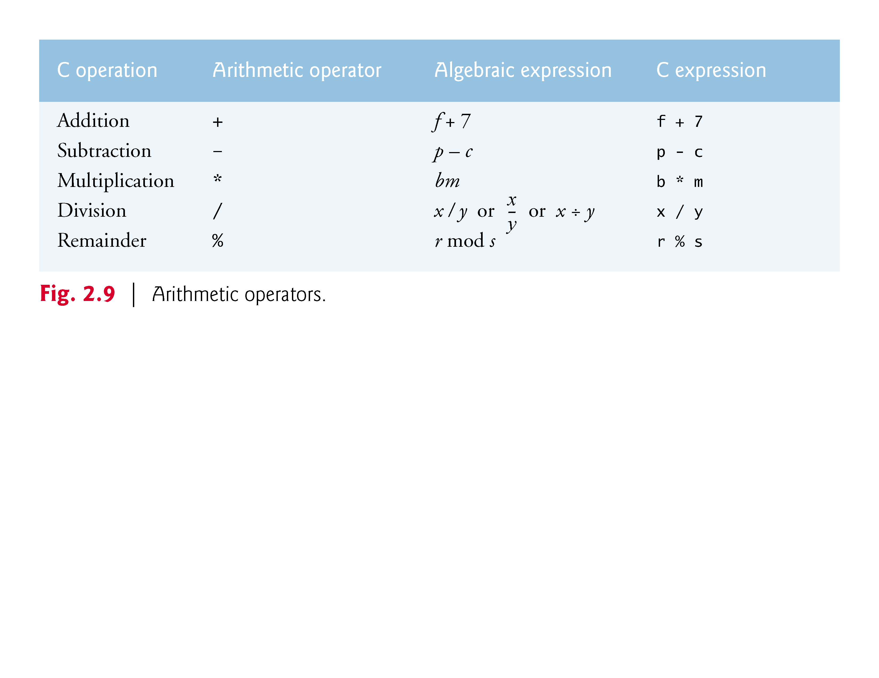

Slide 66
2.5 Arithmetic in C (Cont.)
Integer Division and the Remainder Operator
Integer division yields an integer result
For example, the expression 7 / 4 evaluates to 1 and the expression 17 / 5 evaluates to 3
C provides the remainder operator, %, which yields the remainder after integer division
Can be used only with integer operands
The expression x % y yields the remainder after x is divided by y
Thus, 7 % 4 yields 3 and 17 % 5 yields 2

Slide 67
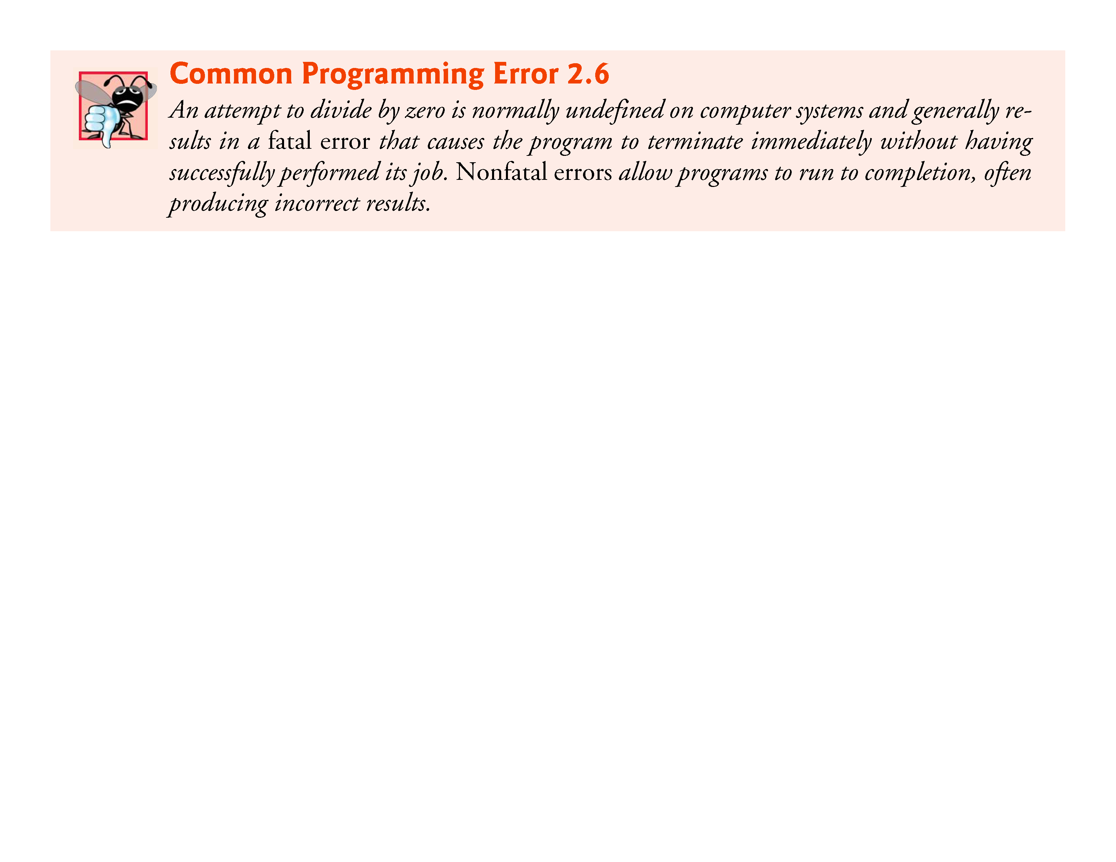

Slide 68
2.5 Arithmetic in C (Cont.)
Arithmetic Expressions in Straight-Line Form
Arithmetic expressions in C must be written in straight-line form to facilitate entering programs into the computer.
Thus, expressions such as “a divided by b” must be written as a/b so that all operators and operands appear in a straight line.
The algebraic notation
a
______
b
is generally not acceptable to compilers, although some special-purpose software packages do support more natural notation for complex mathematical expressions.

Slide 69
2.5 Arithmetic in C (Cont.)
Parentheses for Grouping Subexpressions
Parentheses are used in C expressions in the same manner as in algebraic expressions.
For example, to multiply a times the quantity b + c we write a * ( b + c ).

Slide 70
2.5 Arithmetic in C (Cont.)
Rules of Operator Precedence
C applies the operators in arithmetic expressions in a precise sequence determined by the following rules of operator precedence, which are generally the same as those in algebra:
Operators in expressions contained within pairs of parentheses are evaluated first. Parentheses are said to be at the “highest level of precedence.” In cases of nested, or embedded, parentheses, such as
( ( a + b ) + c )
the operators in the innermost pair of parentheses are applied first.

Slide 71
2.5 Arithmetic in C (Cont.)
Multiplication, division and remainder operations are applied next. If an expression contains several multiplication, division and remainder operations, evaluation proceeds from left to right. Multiplication, division and remainder are said to be on the same level of precedence.
Addition and subtraction operations are evaluated next. If an expression contains several addition and subtraction operations, evaluation proceeds from left to right. Addition and subtraction also have the same level of precedence, which is lower than the precedence of the multiplication, division and remainder operations.
The assignment operator (=) is evaluated last.

Slide 72
2.5 Arithmetic in C (Cont.)
The rules of operator precedence specify the order C uses to evaluate expressions. When we say evaluation proceeds from left to right, we’re referring to the associativity of the operators.
We’ll see that some operators associate from right to left.
Figure 2.10 summarizes these rules of operator precedence for the operators we’ve seen so far.

Slide 73
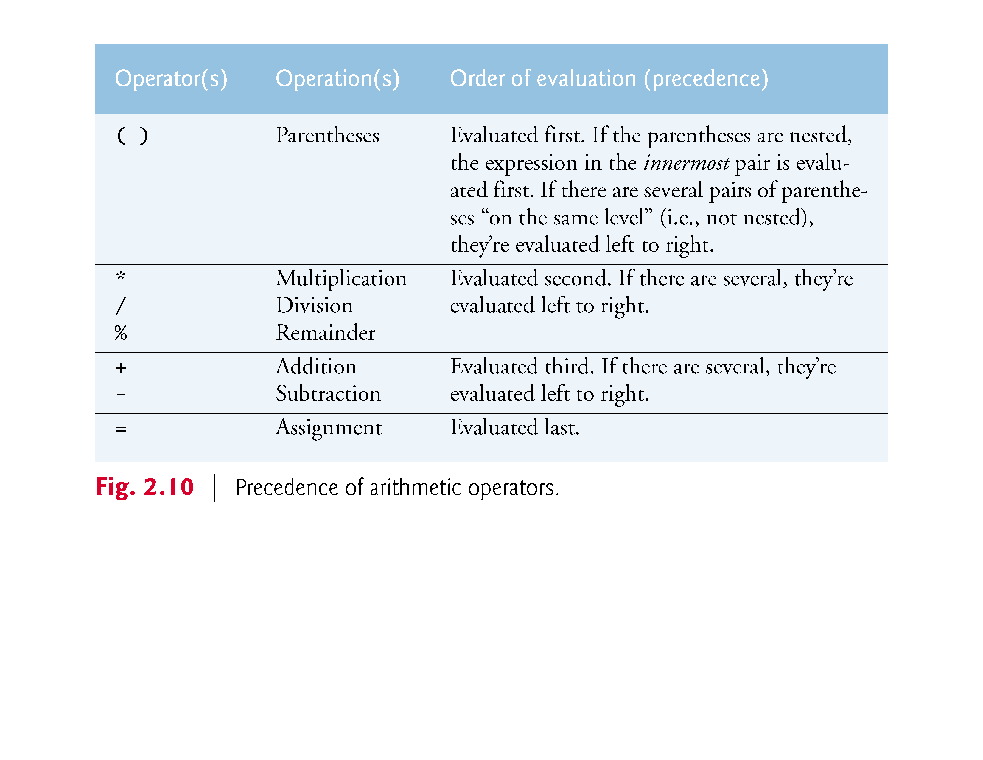

Slide 74
2.5 Arithmetic in C (Cont.)
Figure 2.11 illustrates the order in which the operators are applied.

Slide 75
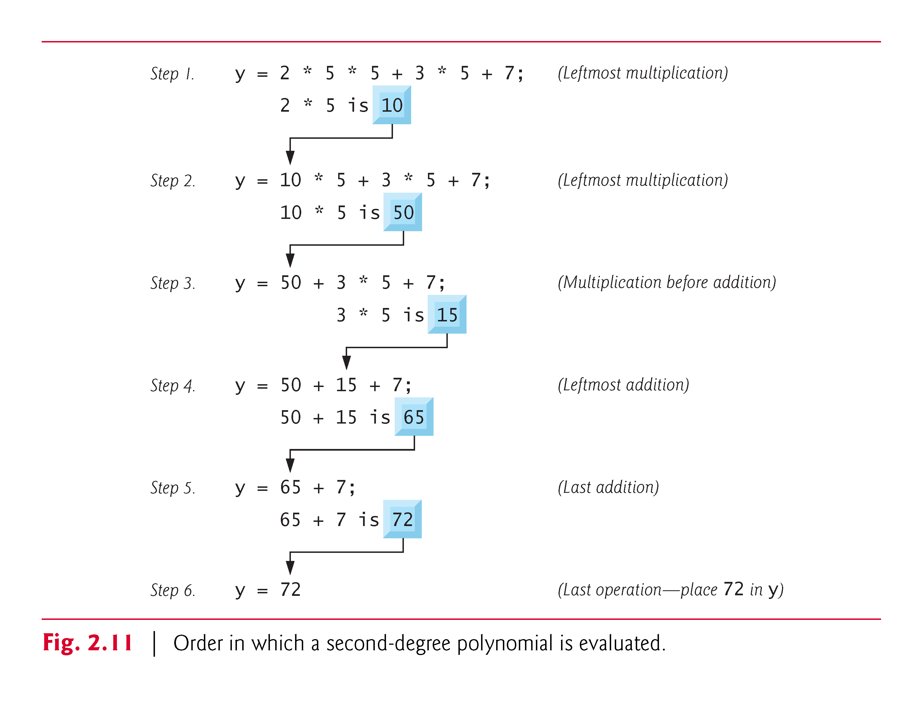

Slide 76
2.5 Arithmetic in C (Cont.)
As in algebra, it’s acceptable to place unnecessary parentheses in an expression to make the expression clearer.
These are called redundant parentheses.

Slide 77
2.6 Decision Making: Equality and Relational Operators
Executable C statements either perform actions (such as calculations or input or output of data) or make decisions (we’ll soon see several examples of these).
We might make a decision in a program, for example, to determine whether a person’s grade on an exam is greater than or equal to 60 and whether the program should print the message “Congratulations! You passed.”
This section introduces a simple version of C’s if statement that allows a program to make a decision based on the truth or falsity of a statement of fact called a condition.

Slide 78
2.6 Decision Making: Equality and Relational Operators
If the condition is true (i.e., the condition is met) the statement in the body of the if statement is executed.
If the condition is false (i.e., the condition isn’t met) the body statement is not executed.
Whether the body statement is executed or not, after the if statement completes, execution proceeds with the next statement after the if statement.
Conditions in if statements are formed by using the equality operators and relational operators summarized in Fig. 2.12.

Slide 79
2.6 Decision Making: Equality and Relational Operators
The relational operators all have the same level of precedence and they associate left to right.
The equality operators have a lower level of precedence than the relational operators and they also associate left to right.
In C, a condition may actually be any expression that generates a zero (false) or nonzero (true) value.

Slide 80


Slide 81
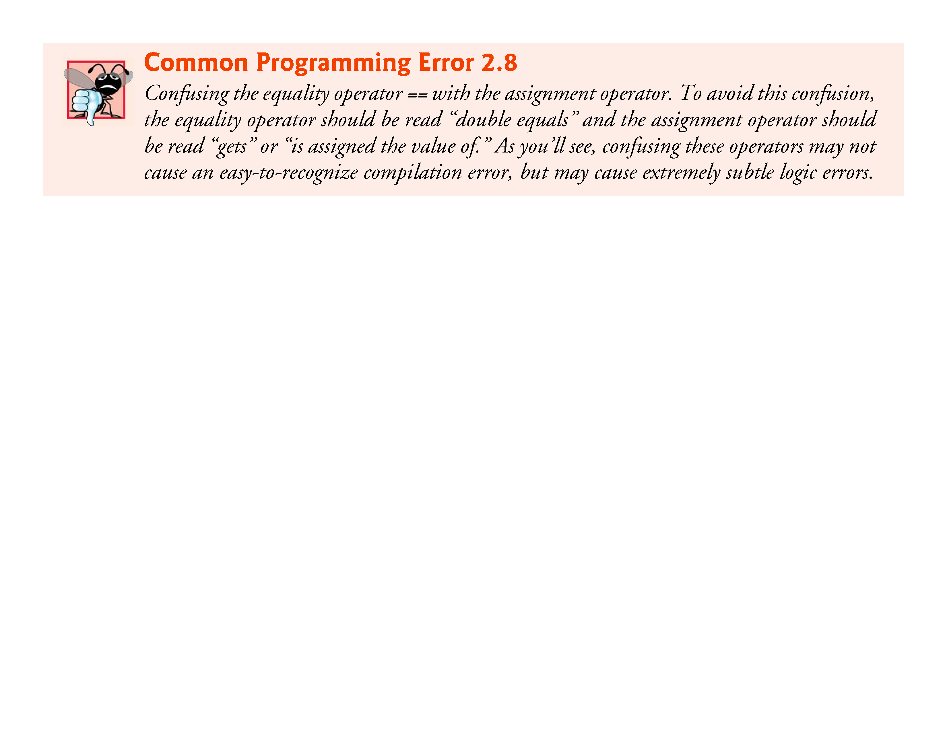

Slide 82
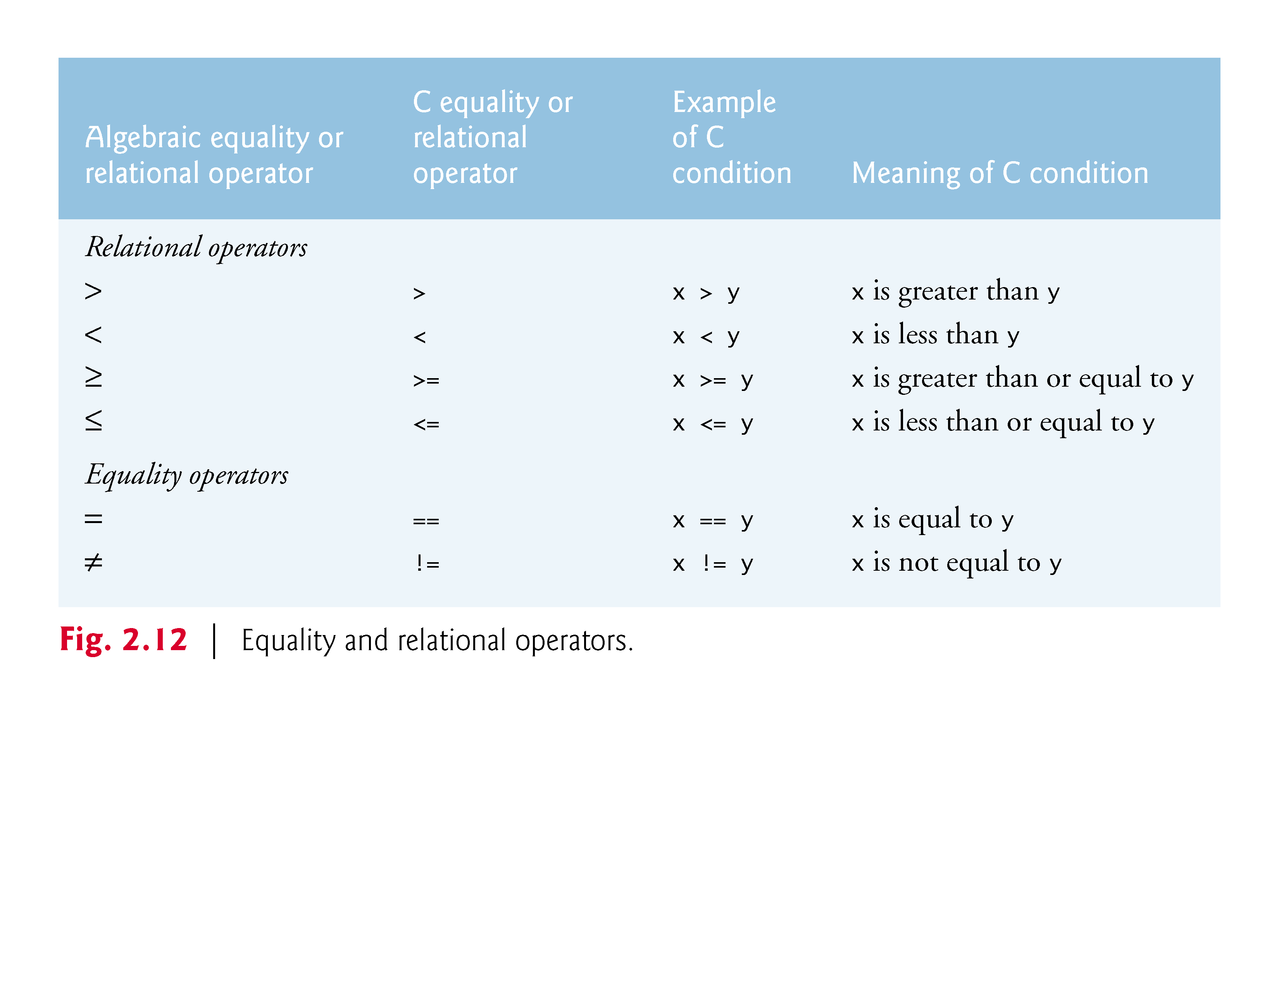

Slide 83
2.6 Decision Making: Equality and Relational Operators
Figure 2.13 uses six if statements to compare two numbers entered by the user.
If the condition in any of these if statements is true, the printf statement associated with that if executes.

Slide 84
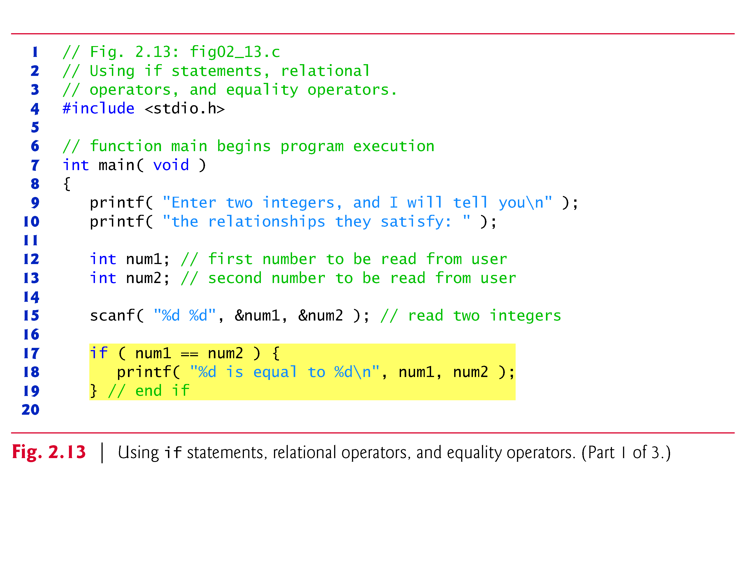

Slide 85
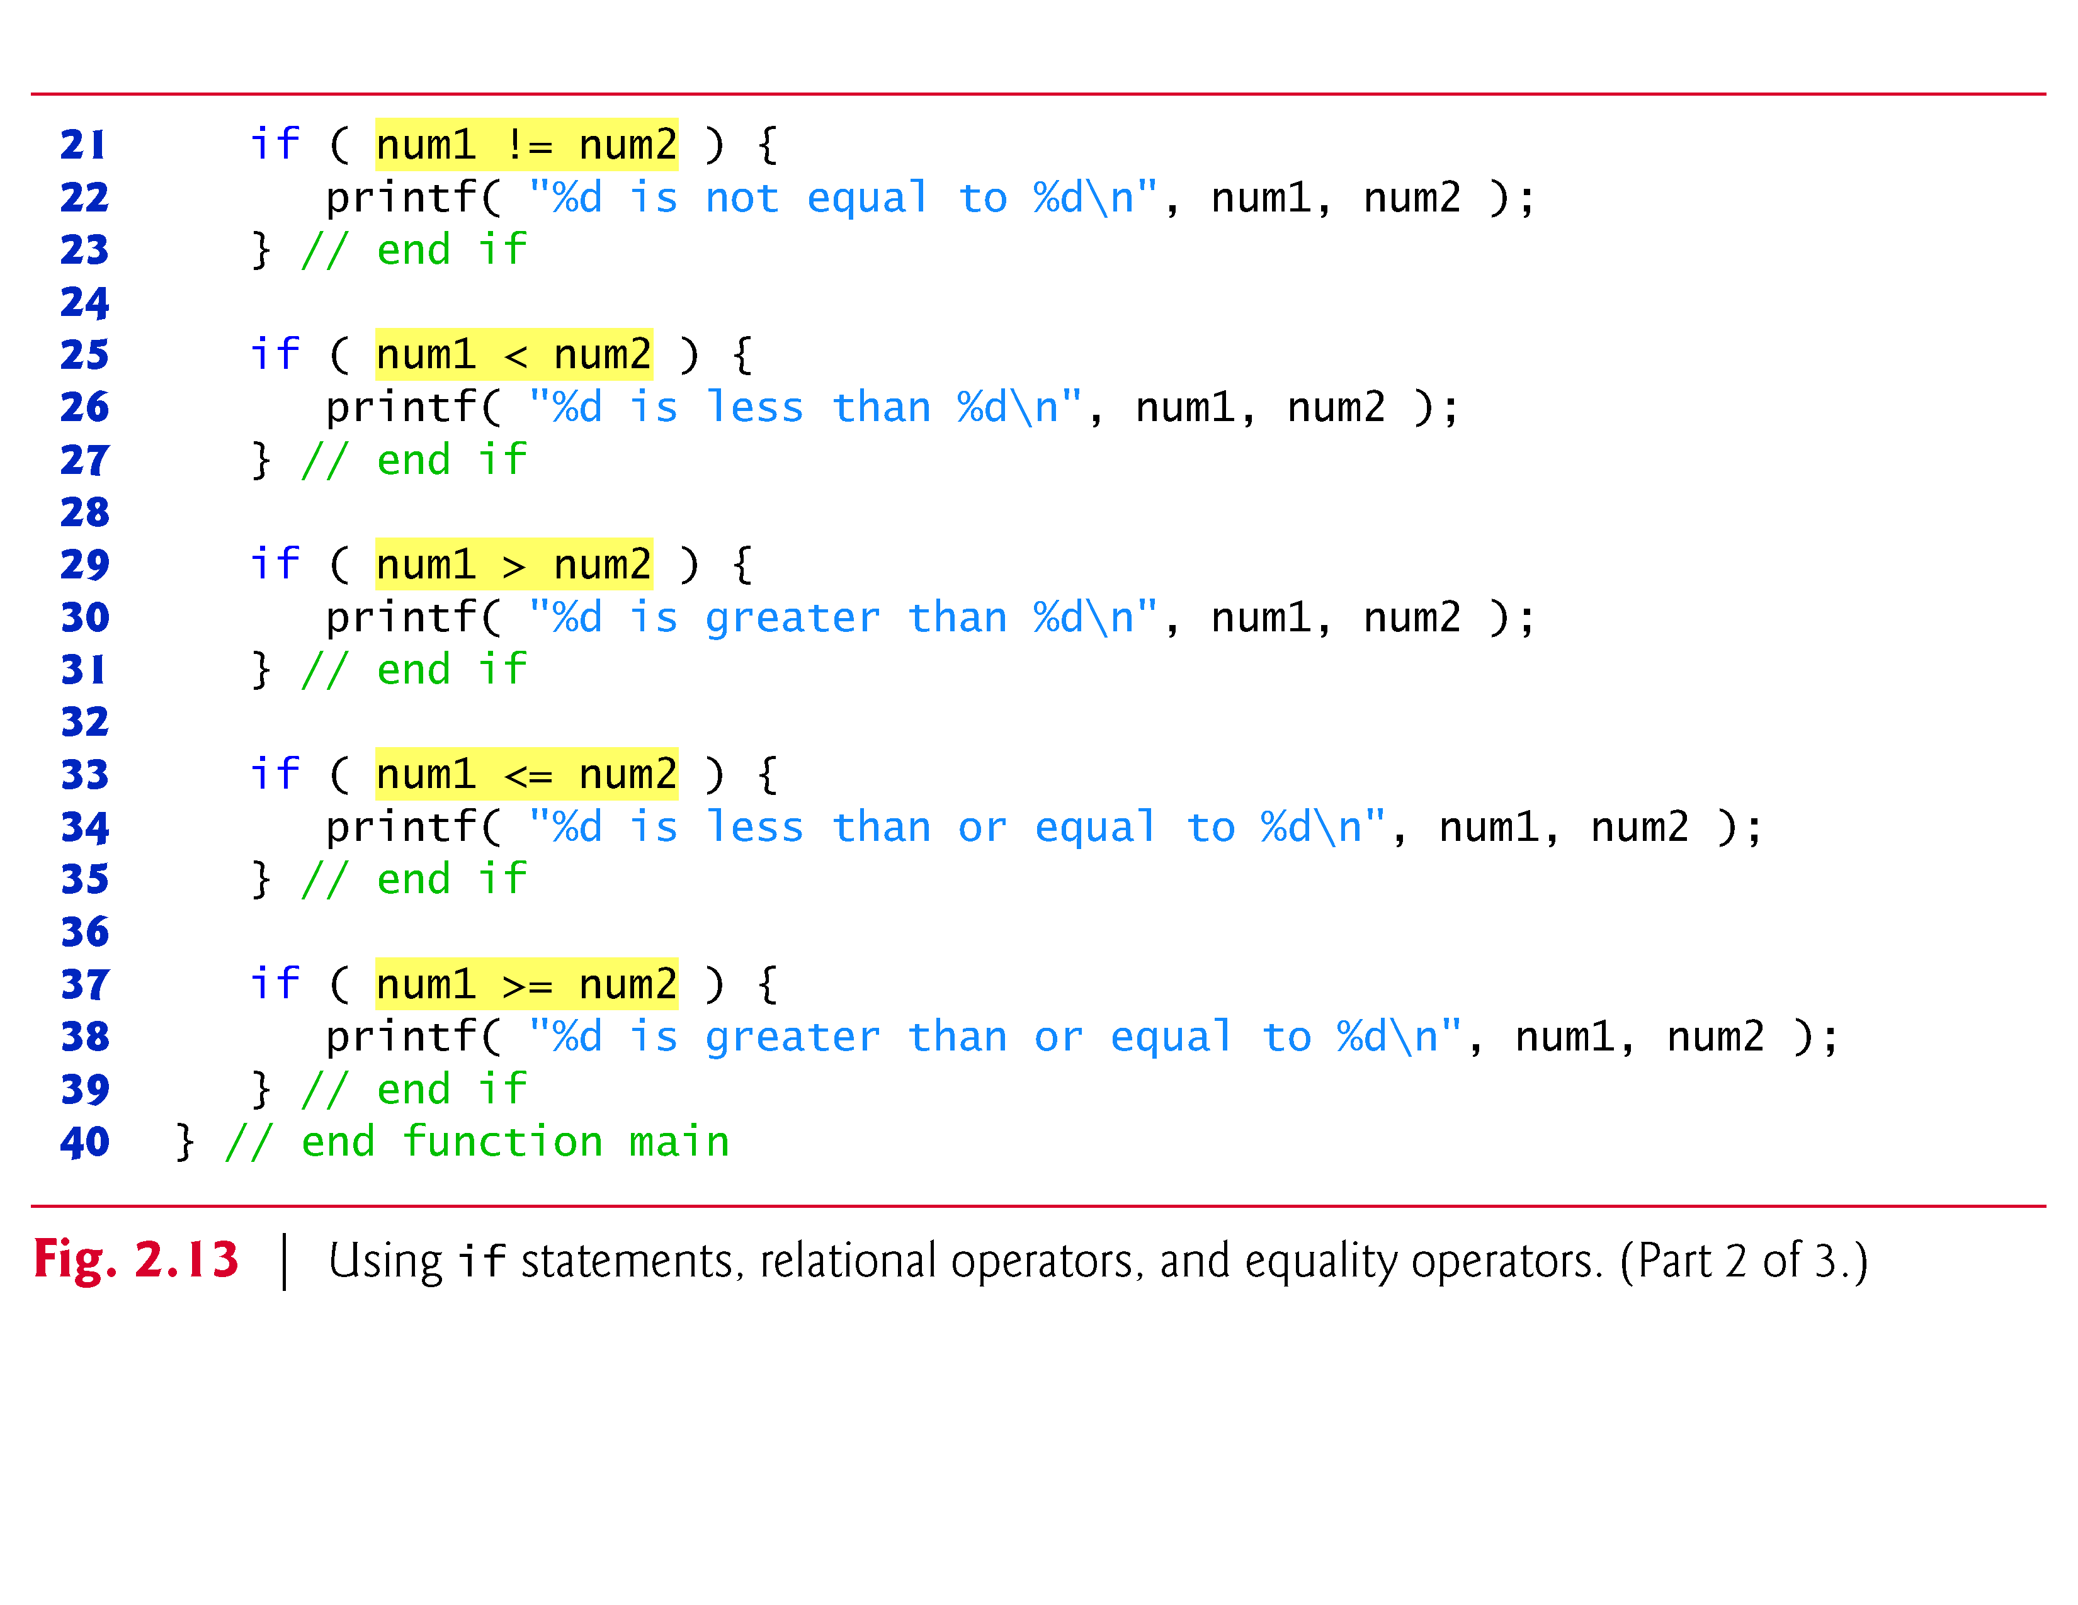

Slide 86
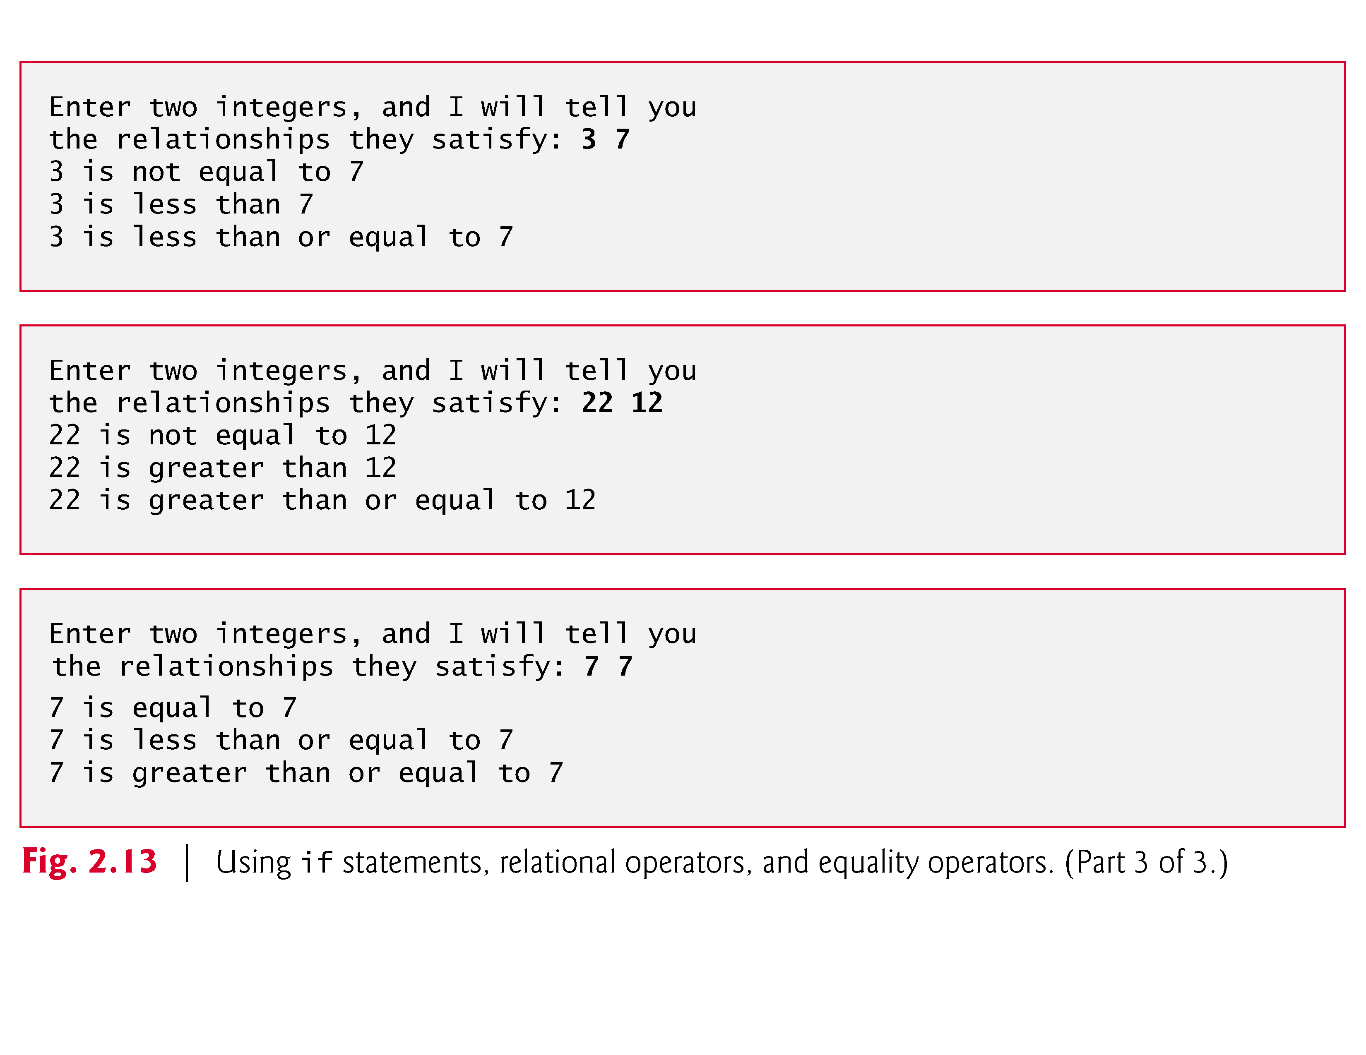

Slide 87
2.6 Decision Making: Equality and Relational Operators
The program uses scanf to input two numbers.
Each conversion specifier has a corresponding argument in which a value will be stored.
The first %d converts a value to be stored in the variable num1, and the second %d converts a value to be stored in variable num2.

Slide 88
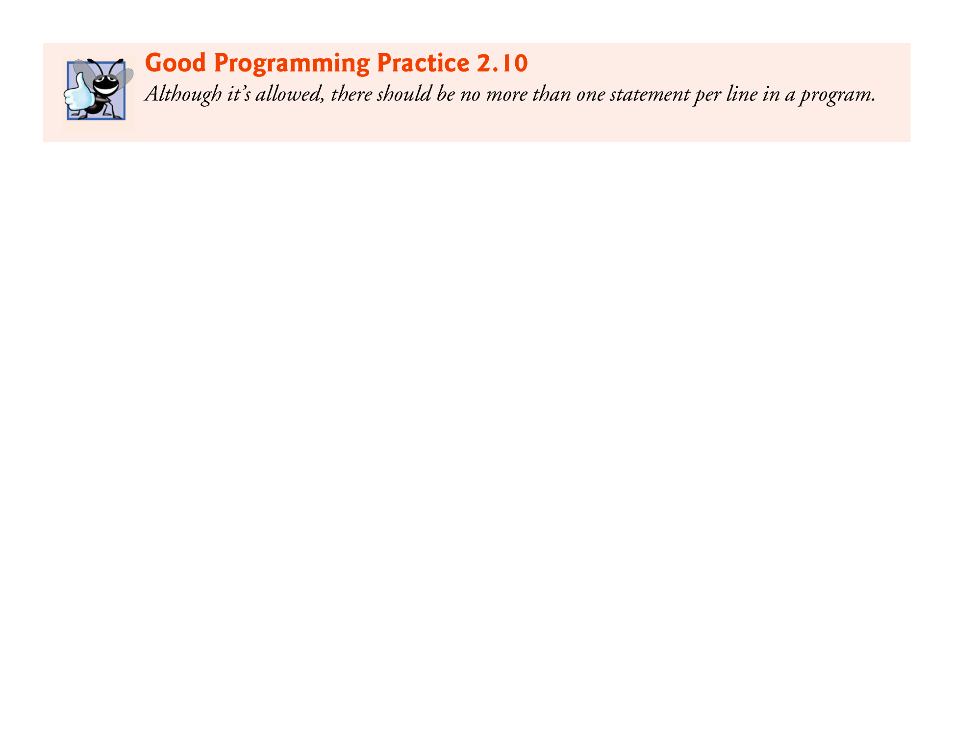

Slide 89
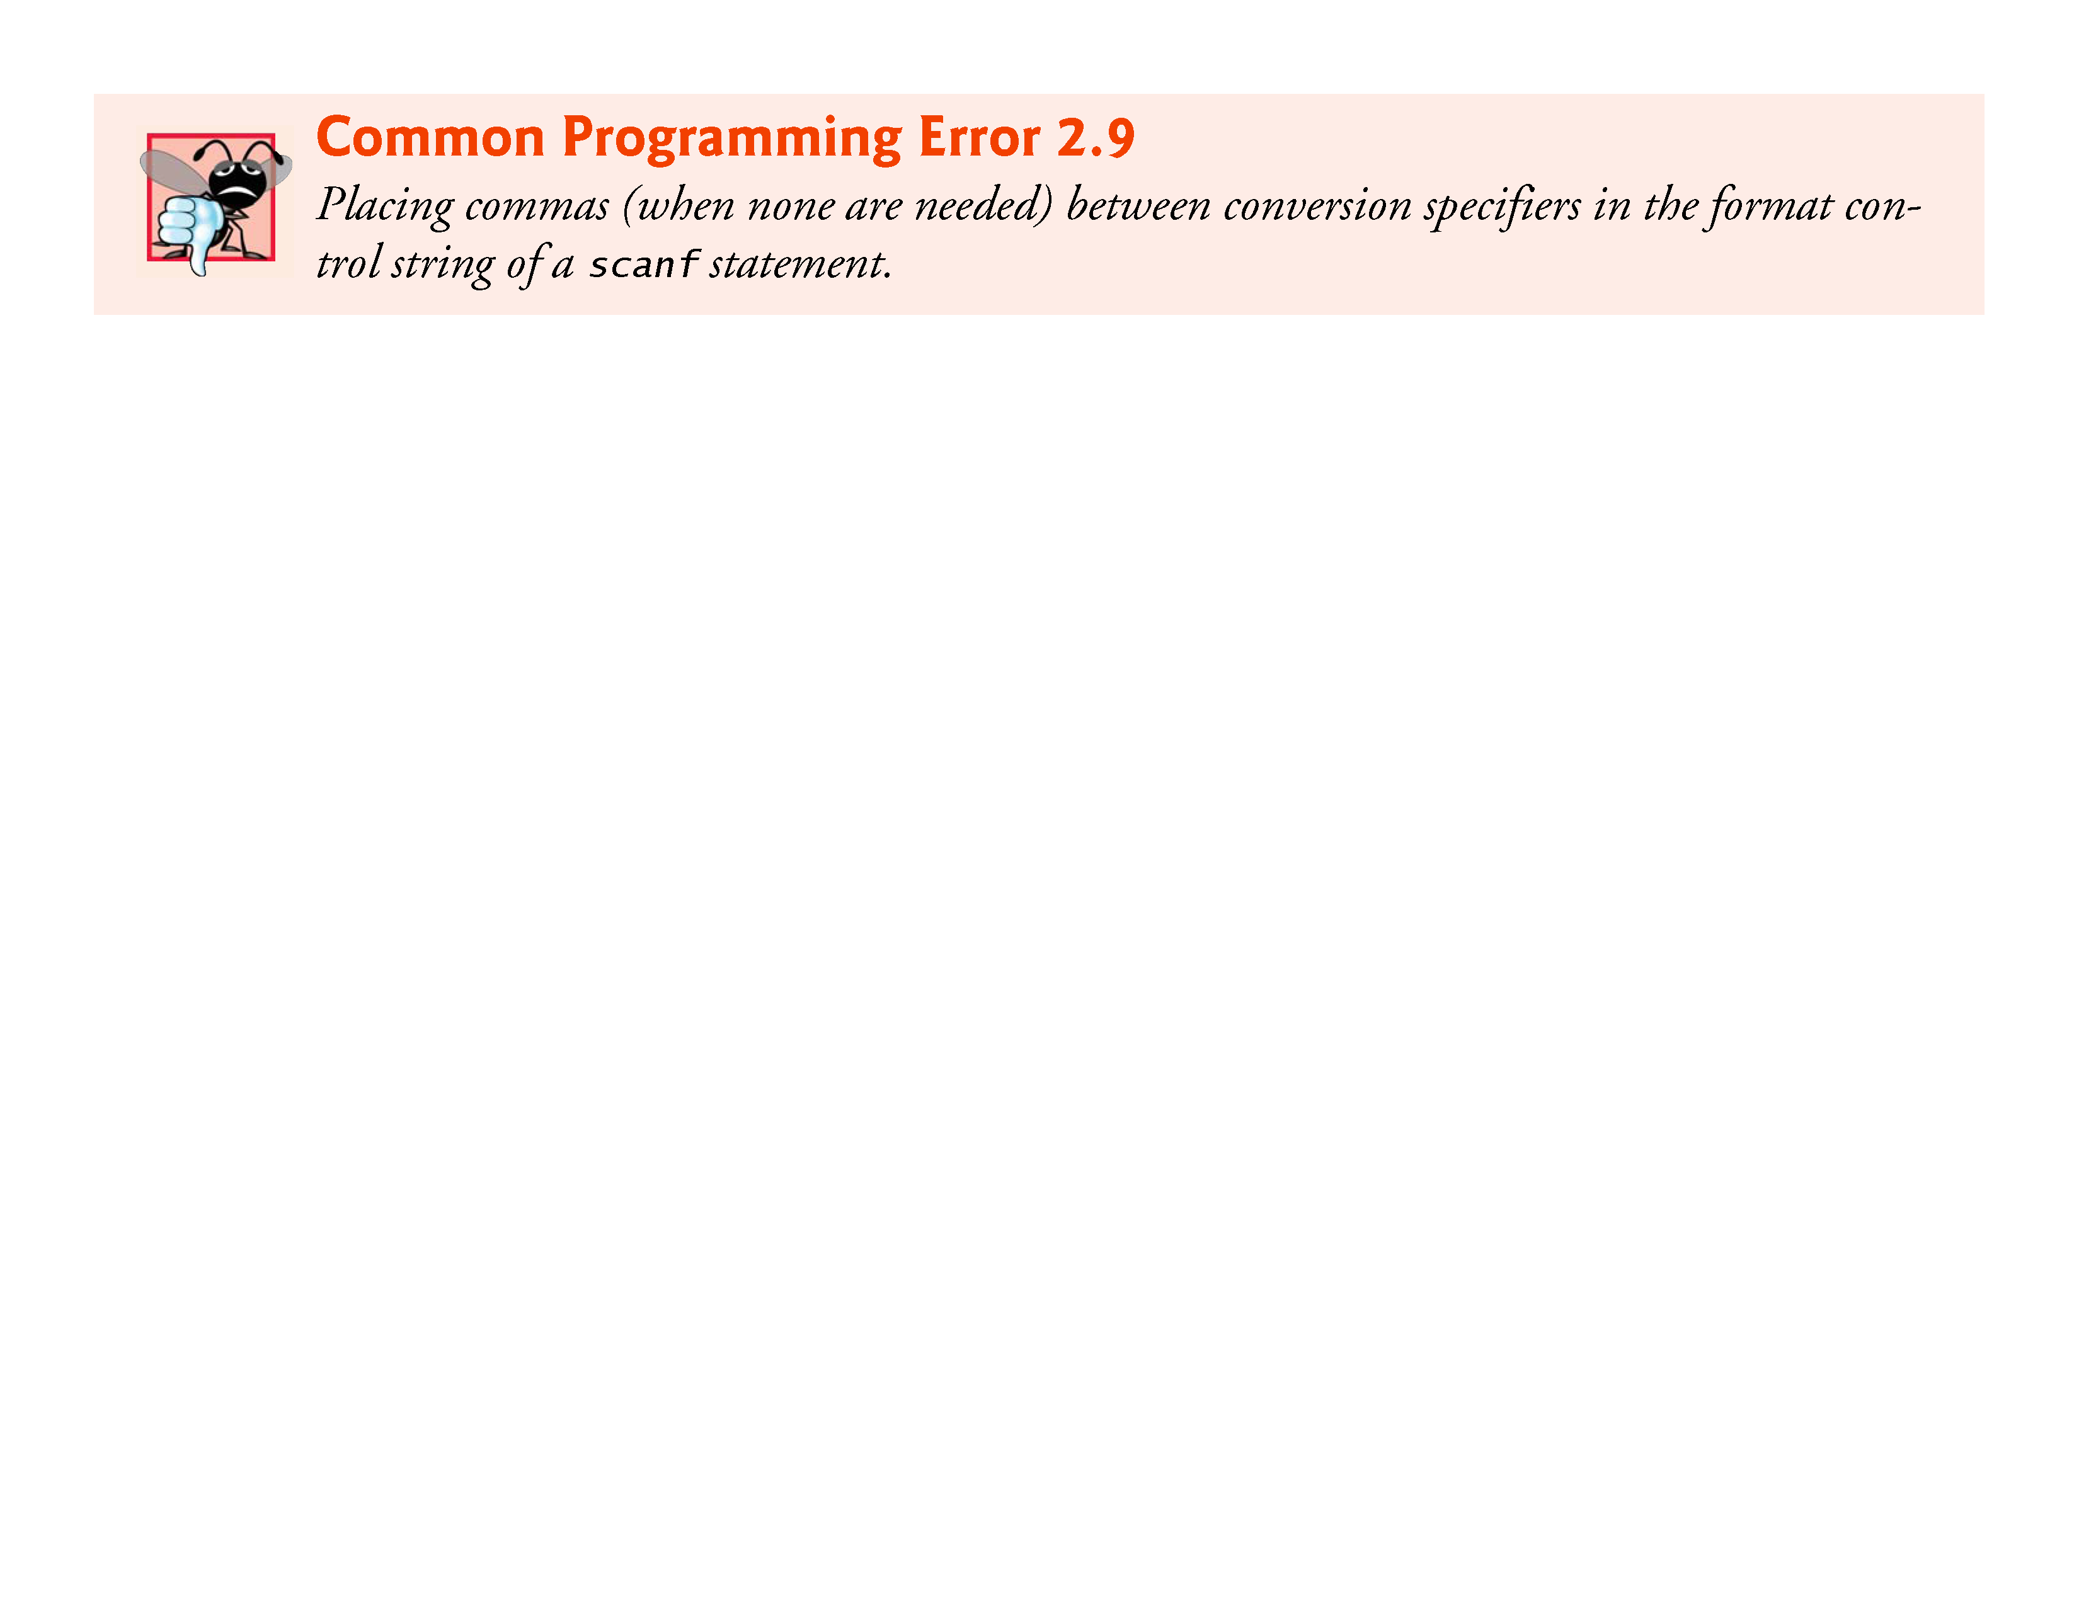

Slide 90
2.6 Decision Making: Equality and Relational Operators
Comparing Numbers
The if statement
if ( num1 == num2 ) {
printf( "%d is equal to %d\n", num1, num2 );
}
compares the values of variables num1 and num2 to test for equality.
If the conditions are true in one or more of the if statements, the corresponding body statement displays an appropriate line of text.
Indenting the body of each if statement and placing blank lines above and below each if statement enhances program readability.

Slide 91


Slide 92
2.6 Decision Making: Equality and Relational Operators
A left brace, {, begins the body of each if statement
A corresponding right brace, }, ends each if statement’s body
Any number of statements can be placed in the body of an if statement.

Slide 93
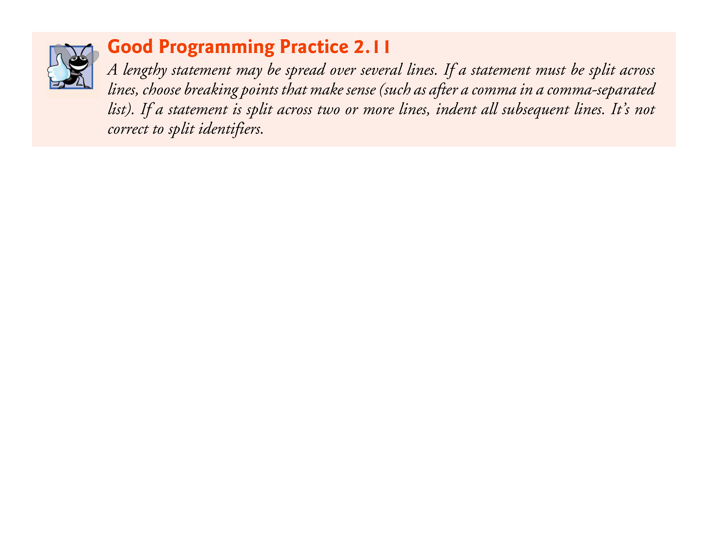

Slide 94
2.6 Decision Making: Equality and Relational Operators
Figure 2.14 lists from highest to lowest the precedence of the operators introduced in this chapter.
Operators are shown top to bottom in decreasing order of precedence.
The equals sign is also an operator.
All these operators, with the exception of the assignment operator =, associate from left to right.
The assignment operator (=) associates from right to left.

Slide 95
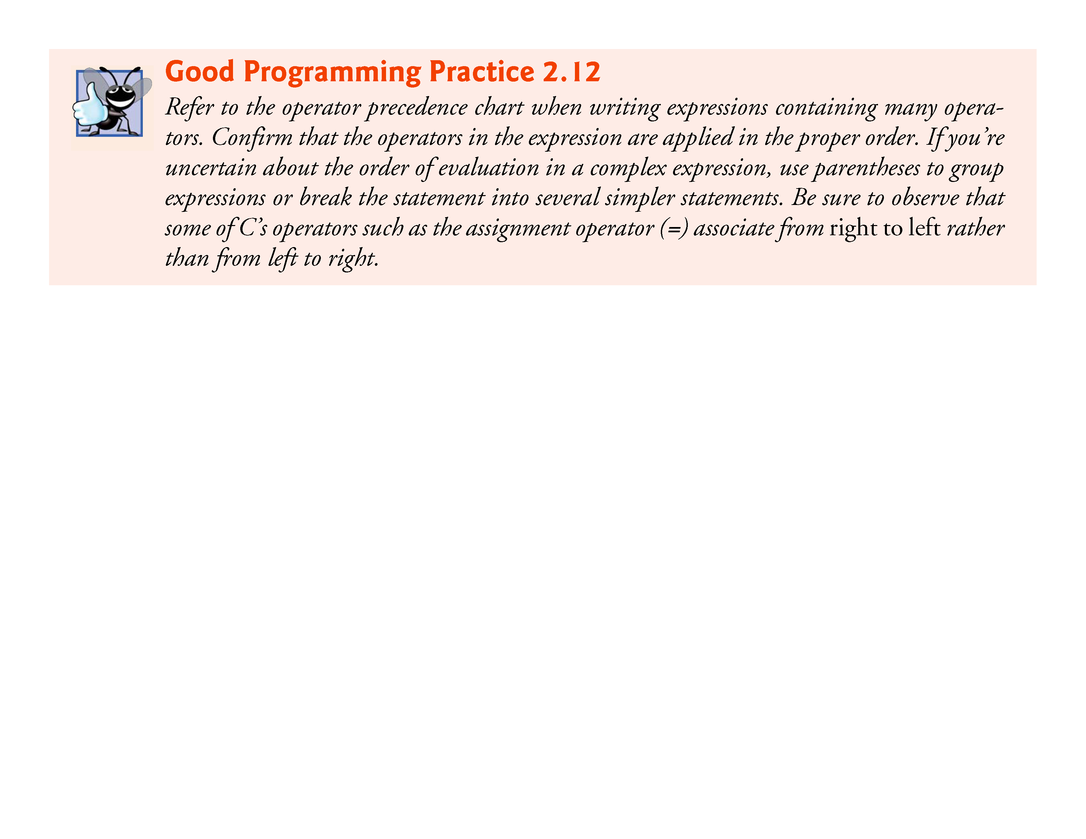

Slide 96
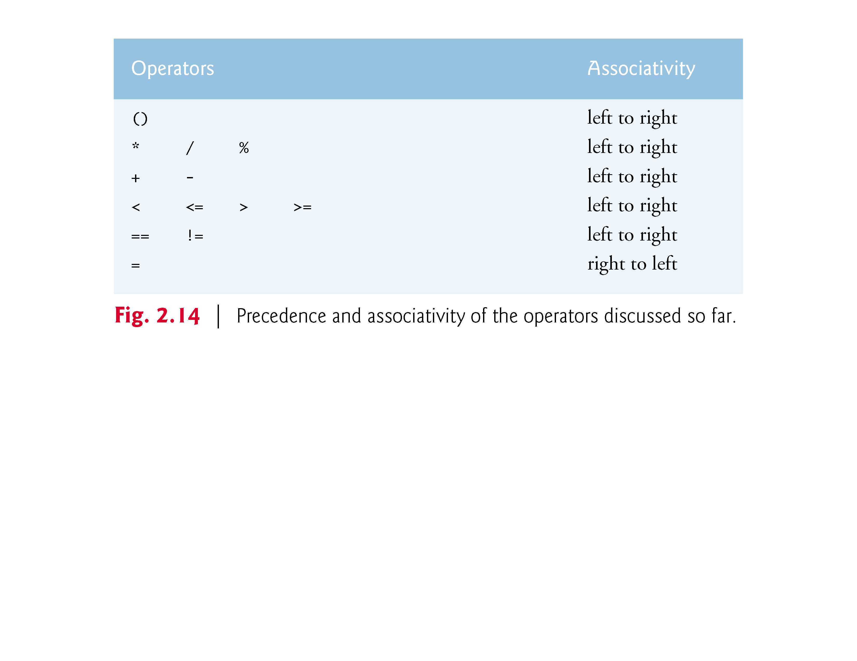

Slide 97
2.6 Decision Making: Equality and Relational Operators
Some of the words we’ve used in the C programs in this chapter—in particular int and if—are keywords or reserved words of the language.
Figure 2.15 contains the C keywords.
These words have special meaning to the C compiler, so you must be careful not to use these as identifiers such as variable names.

Slide 98
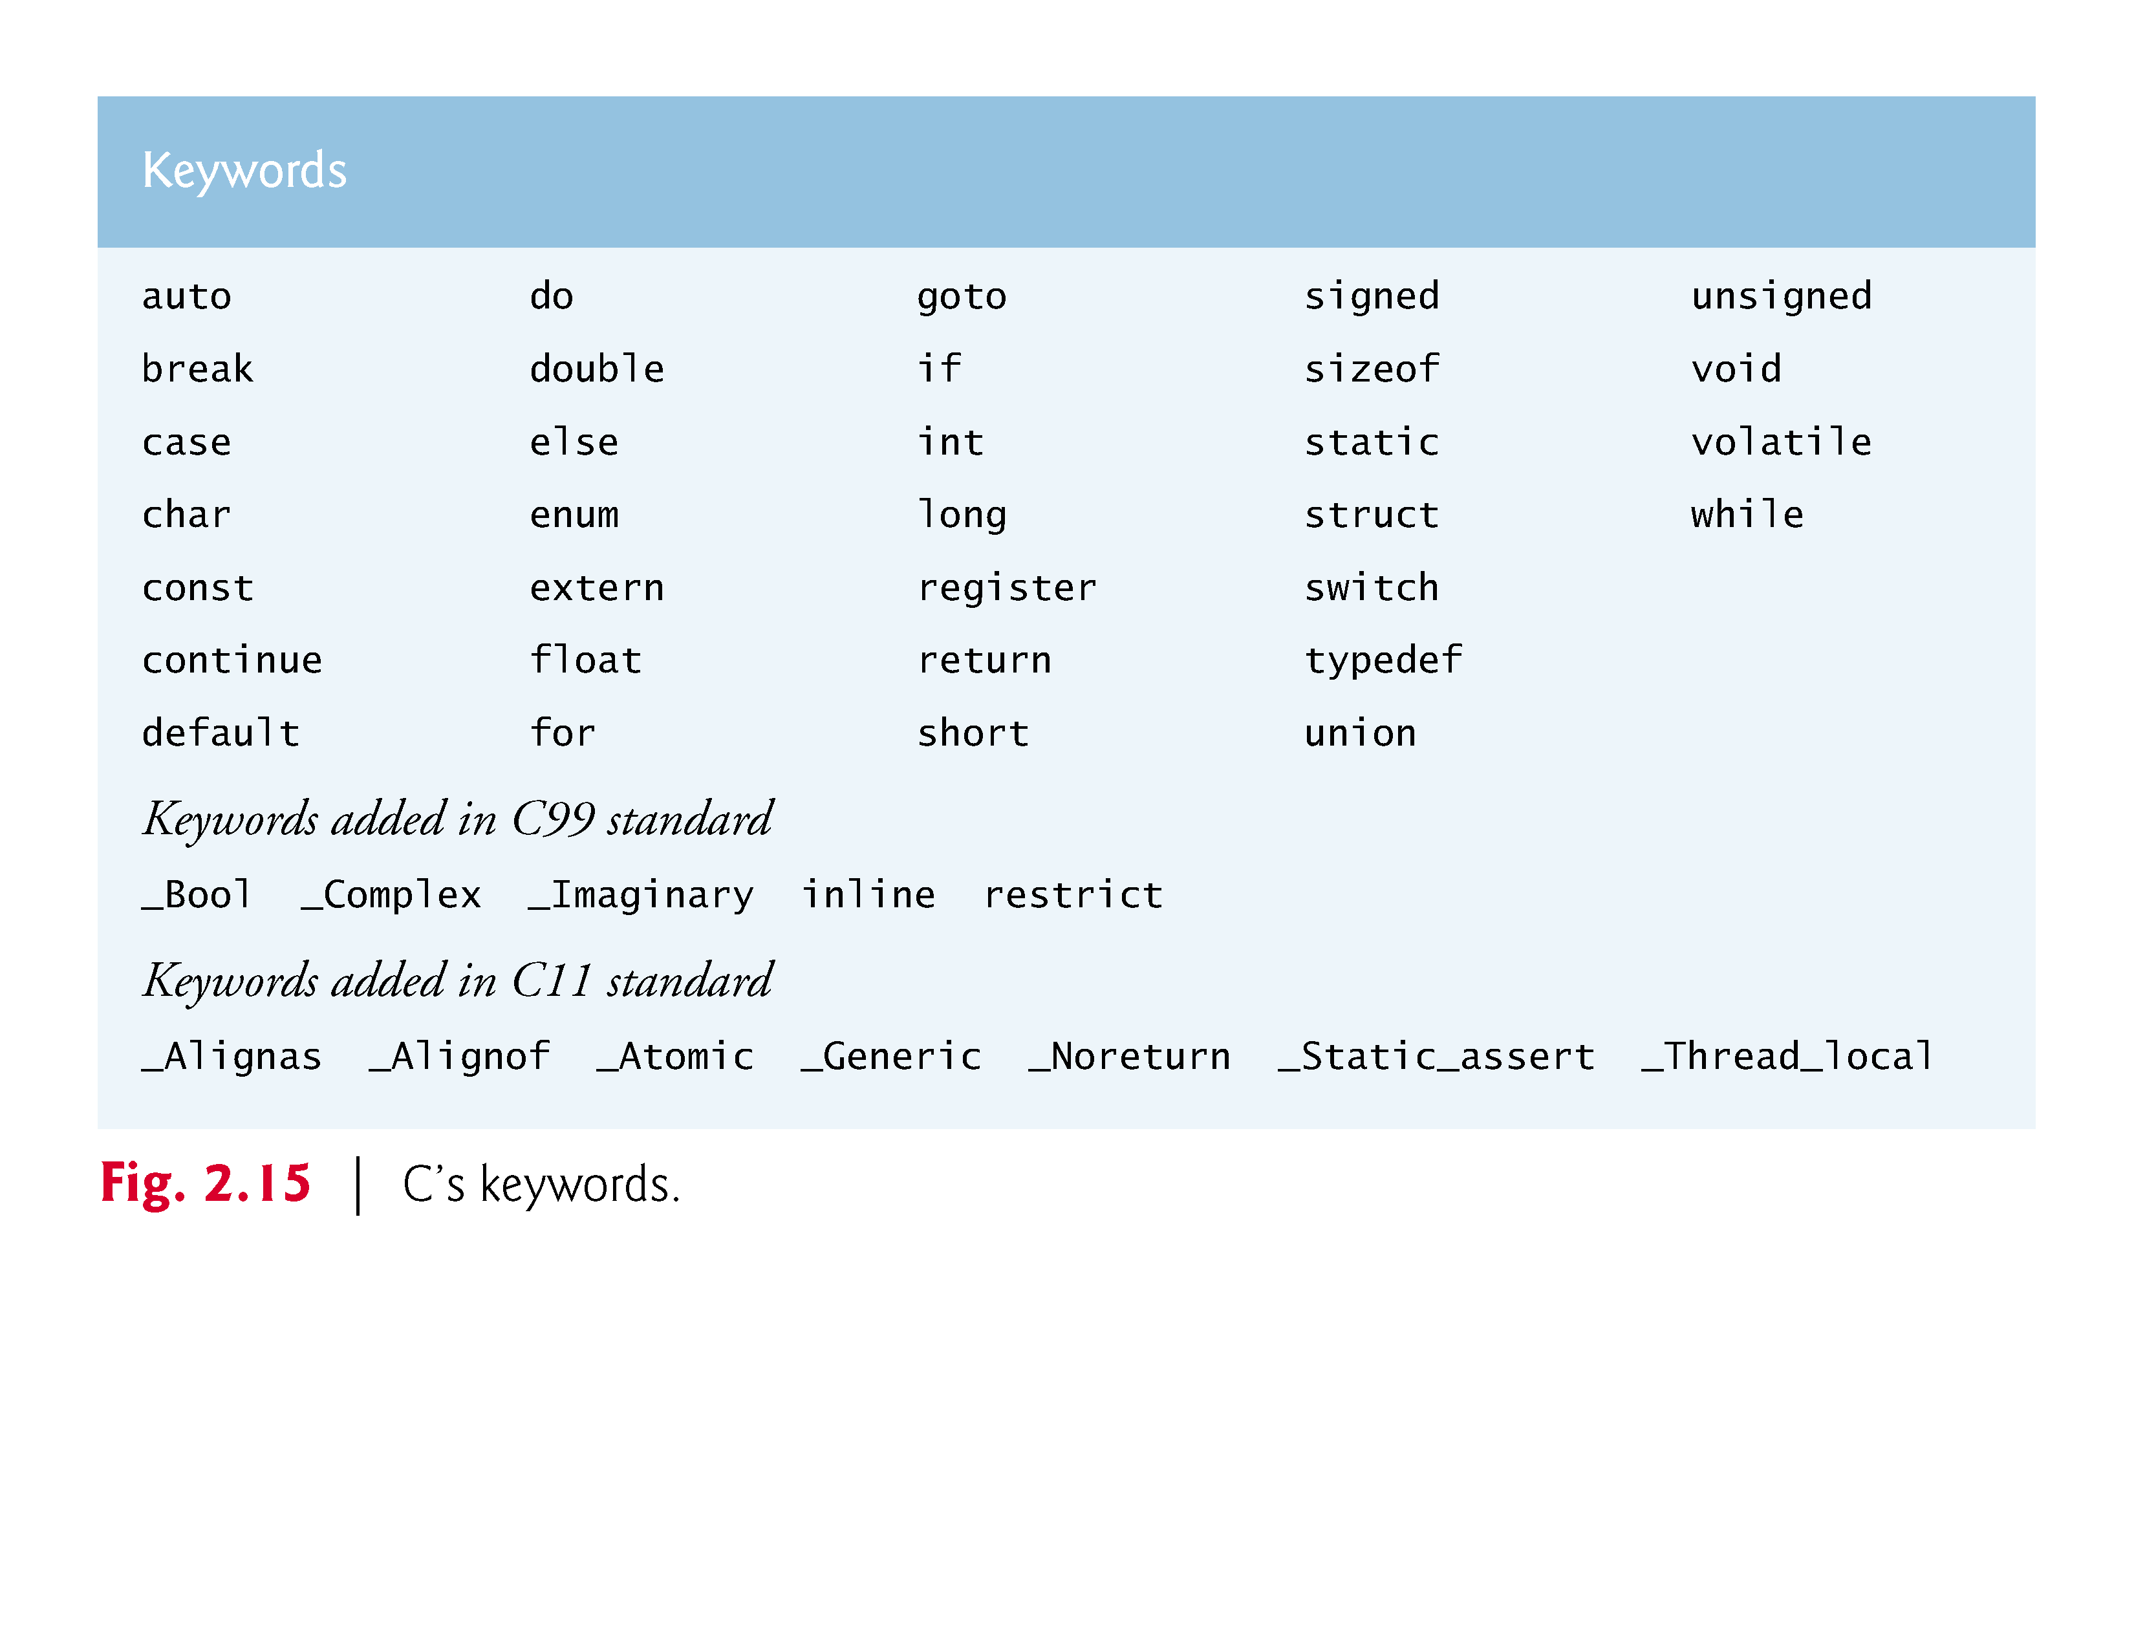

Slide 99
2.7 Secure C Programming
CERT C Secure Coding Standard
Guidelines that help you avoid programming practices that open systems to attacks
Avoid Single-Argument printfs
If you need to display a string that terminates with a newline, use the puts function, which displays its string argument followed by a newline character
For example
printf( "Welcome to C!\n" );
should be written as:
puts( "Welcome to C!" );
We did not include \n in the preceding string because puts adds it automatically.

Slide 100
2.7 Secure C Programming (cont.)
If you need to display a string without a terminating newline character, use printf with two arguments.
For example
printf( "Welcome " );
should be written as:
printf( "%s", "Welcome " );
These changes are responsible coding practices that eliminate certain security C vulnerabilities as we get deeper into C

